Slide 1
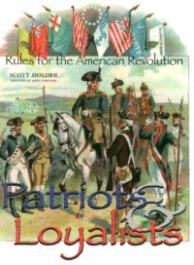
THE WAR FOR INDEPENDENCE 1776 – 1783 (CH.9-12)
A minority of Americans supported the Revolution.
1.Two-fifths were Patriots
2. One-fifth were Loyalist
3. remainder were neutral.
The American Revolution split families and neighbors.
New England and Virginia had the greatest share of Patriots
New York State and the Carolinas had the greatest amount of Loyalist.
Quakers and the German population made up most of the neutral party.
Loyalist suffered harsh treatment.
80,000 fled to Britain’s other colony in North America.
Most Indians sided with the British. WHY?

Slide 2
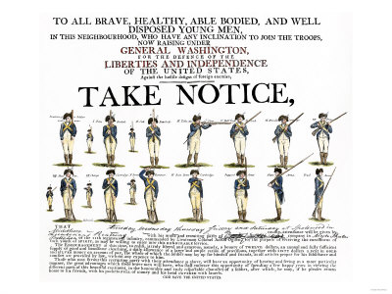
PROBLEMS
Washington had problems obtaining supplies: shoes, soap, food, guns, ammunition, wagons, horses, clothes, tents.
The Continental Currency was becoming worthless and some suppliers were refusing to accept it. WHY?
Washington had trouble getting men to enlist for long terms.
1. He was often dealing with inexperienced troops.
2. Many were poor farmers = promise of free land
3. Hope to gain money and social standing.
4. 5,000 African Americans served in the Continental Army. (Washington not sure)
5. Many women went with their husbands to battle. (Why was this important?)

Slide 3
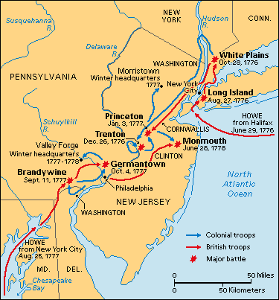
THE NORTHERN CAMPAIGNS 1776-1778
When the British left Boston in March of 1776, Washington guessed that they would reappear in New York City.
1. If the Hudson Valley was controlled the British could divide the country in two.
2. Washington stationed troops on Manhattan and Long Island.
3. July 1776 General Howe of Great Britain arrived (32,000 soldiers, hundreds of ships)
Americans = 13,000 soldiers and 13 ships total.
By November 1776 Washington was pushed back into New Jersey.
By December British General Lord Cornwallis pushed Washington across the Delaware River into Pennsylvania.

Slide 4
THE CROSSING OF THE DELAWARE
During the winter, Howe left the Hessians in New Jersey and he went to the comfort of New York. WHY?
The Patriots spirits fell, the colonial army went form 20,000 to a few thousand.
Thomas Paine wrote THE CRISIS = “THESE ARE THE TIMES THAT TRY MEN’S SOULS”
Washington gambles = Dec. 25, 1776 Patriot troops rowed across the Delaware River to New Jersey
They caught the Hessians at Trenton, New Jersey sleeping off their Christmas dinner.
1. Over 1,000 Hessians were captured or killed.
2. The Patriots acquired a great number of supplies, guns, and ammunition.
3. Washington marched the captured prisoners through the streets of Philadelphia. WHY?
4. Victories at Trenton and Princeton gave new hope and new recruits.

Slide 5
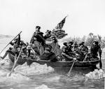
CROSSING THE DELAWARE

Slide 6
BATTLE OF SARATOGA
BRITISH PLANS =SUMMER OF 1777
1. A British Army moved south from Canada.
2. A British force moved east from Lake Ontario.
3. Howe was to move north from New York
4. the Armies were to meet in Albany securing the Hudson Valley. (Philadelphia fell and the colonist moved the Continental Congress to York)
Howe decided not to move north.
The force from the north moved slow (General “Gentleman Johnny” Burgoyne) , allowed the Patriots time to cut down trees across roads, burn crops, drive off cattle.
Patriot forces destroyed the Hessians at the Battle of Bennington in Vermont.

Slide 7
SARATOGA CONTINUED
Burgoyne’s weakened army approached Albany = faced a powerful American army under Horatio Gates.
Howe should have closed in on Gates?
BACK IN PHILADELPHIA
At the BATTLE OF SARATOGA, October 1777, Gates and Benedict Arnold crushed Burgoyne = he surrendered his force of 6,000 troops.
This persuaded the French to back the Patriots. WHY?
Spain also joined, together with France they donated money and supplies.
George III declared war on France.
Britain declared war on Holland = loaned money to America, Dutch merchants sold gunpowder to the Americans.

Slide 8
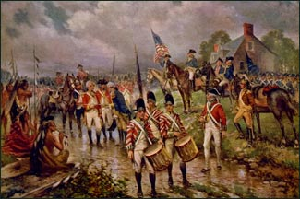
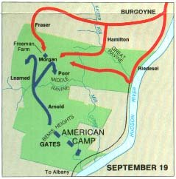
SARATOGA

Slide 9
VALLEY FORGE
Driven from Philadelphia by Howe, Washington spent the winter of 1777-78 at Valley Forge.
1. No supplies
2. One-quarter of the soldiers died (cold, smallpox, hunger, typhoid)
3. Many soldiers deserted.
GOOD NEWS = Europeans came to help fight.
1. Marquis de Lafayette (France, great leader, no pay)
2. Casimir Pulaski and Thaddeus Kosciusko planned defenses along the Hudson River.
Baron von Steuben (Germany), trained Washington’s troops all winter. (European formations and bayonet attacks).
The Colonial army could now fight with the best.

Slide 10
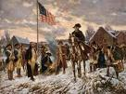
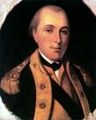
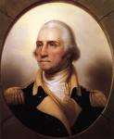
VALLEY FORGE

Slide 11
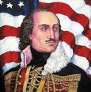
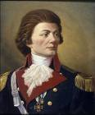
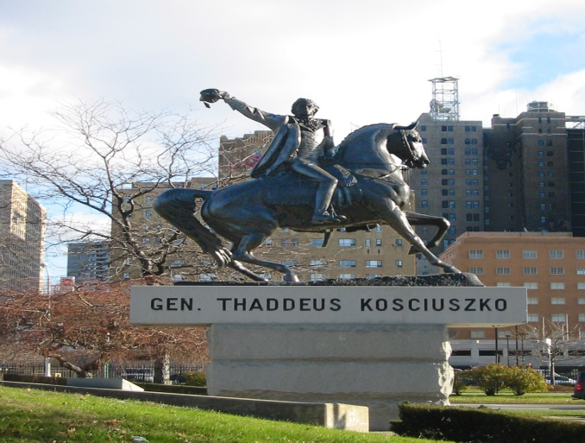
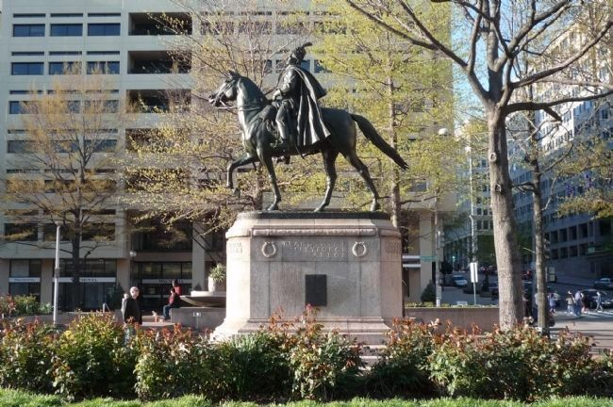
POLISH COMMANDERS
CASIMIR PULASKI
THADDEUS KOSCIUSKO

Slide 12
WAR IN THE SOUTH
The British strategy in the North was not working.
The British generals decided to shift the focus of the war to the South.
1. Many Southern Loyalists
2. Many slaves (50,000)
From 1778-to the end of the war most of the major battles took place in the South.
The British captured ports at Savannah, Georgia and Charleston, South Carolina.
General Cornwallis set out to secure the Southern countryside – some of the war’s most bitter fighting followed.
Guerilla warfare followed by bands of Patriots and Loyalist.
All existing rules of warfare were dropped.
Colonel Tarleton “Butcher” (British)
Francis Marion “Swamp Fox” (Patriots) = led raids on the British and fled to the swamps for safety.

Slide 13
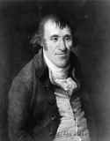
THE SOUTH CONTINUED
After a series of defeats George Washington asked General Gates to form a new Southern Army.
September 1780 – General Benedict Arnold (Saratoga) joined the British.
He had agreed to let the British take the fort at West Point, New York.
He was discovered and the fort saved.
1.Arnold in debt accepted a large payment from the British.
2. Resentful that Gates, not he received most of the credit for Saratoga.
Ethan Allen told the British he would stop fighting for a quarter of a million acres of Vermont land
-Trying to pressure Congress on making Vermont a state.
-TREASON = DEATH

Slide 14
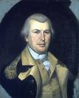
THE TIDE TURNS IN THE SOUTH
In 1780 Washington put Nathanael Greene in charge of the Southern Army.
Greene’s force avoided full scale battles.
They let the British chase them around the country side = wear themselves out.
When they fought, win or lose, they made sure the British suffered heavily.
“Another such victory will destroy the British Army”

Slide 15
THE END OF THE WAR
As the war dragged into its sixth year opposition grew to Britain’s war policy.
Maybe American independence would not be so bad.
The last year of the war was fought mostly in Virginia – Yorktown was a port the British could receive supplies.
6,000 well-trained French Forces came to the aid of the Americans at Rhode Island.
A large French fleet had arrived and was used to cut Yorktown of from supplies.
Washington marched south with his army and the French
French ships drove back the British supply ships.
The Americans and French began to bombard Yorktown.
Cornwallis realized the situation was hopeless.
October 19, 1781 Cornwallis sent up the white flag and surrendered his army of 8,000.
The Battle of Yorktown convinced Britain’s leaders to begin peace talks.

Slide 16
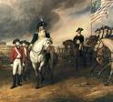
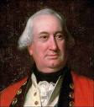
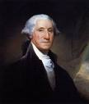
THE SURRENDER

Slide 17
WHY THE AMERICANS WON
The Patriots won the war in spite of many disadvantages.
1. British generals made errors in judgment – promoted for the wrong reasons – overconfident.
2. Britain’s rivals helped the patriots.
3. The British could not control the countryside.
4. The patriots had more to fight for – property, ideals, homes, etc.
COST OF THE WAR:
1. About 25,000 Americans lost their lives.
2. 10,000 British.
3. Many Americans died in prison (captured)
4. Many starved or froze to death.
5. Many left the war penniless (little or no pay) – many had to sell their titles to the western land.
6. The United State went deeply into debt.

Slide 18
TREATY OF PARIS
John Adams, Benjamin Franklin, and John Jay met with British and French diplomats in Paris.
The Americans could not trust the French – only negotiated a Peace with the British, dealt with the French later.
THE TREATY OF PARIS (1783)
1. The U.S. was independent.
2. Boundaries of the U.S. = west to the Mississippi River.
-Canada to the North.
Spanish Florida to the South. (Problems with these. WHY?)
3. The U.S. would have fishing rights off of Newfoundland and Nova Scotia.
4. Each side would repay debts owed before the war.
5. The British would return any slaves they had captured.
Congress would recommend that states give back property taken from Loyalist.

Slide 19
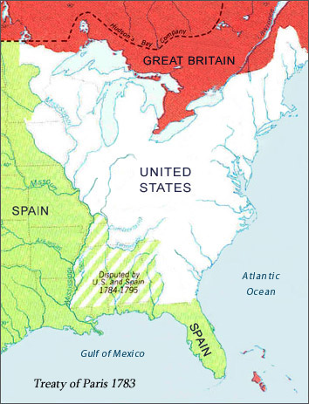
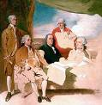
TREATY CONTINUED

Slide 20
PROBLEMS WITH THE TREATY
Neither Britain or the U.S. fully lived up to the terms in the treaty.
1. Americans did not repay their pre-war debts.
2. Americans did not return property to the Loyalist.
3. Britain refused to give up military outpost in the Great Lakes.
Fort Detroit – source of tension for years to come.
SOCIAL CHANGE:
1. Native American Fear = white settlers rushed to seize land west of the Appalachians.
2. Revolutionary leaders took over Loyalist property.
3. More Americans were given land = more people could vote.
4. Many states began abolishing slavery (Massachusetts and New Hampshire the first)
AMERICAN INDEPENDENCE = Led to other revolutions, France, Poland, and even today.

Slide 21
THE AMERICAN REPUBLIC
Most Americans agreed that their new nation should be a REPUBLIC = People choose representatives who make the laws.
They also believed the republic should be based on democratic principles. DEMOCRACY = a system of government by the people.
Between 1776 and 1780, eleven of the thirteen colonies drew up a CONSTITUTION = plan for government.
Connecticut and Rhode Island reworded their COLONIAL CHARTERS = a written agreement between the crown and proprietors.
Never before in history had people written down the rules under which they would be governed.

Slide 22
PRINCIPLES OF THE CONSTITUTIONS
Several principles underlay these constitutions:
1. Compact = People making an agreement for the common good.
2. Good government is based on the consent of the people.
3. fundamental laws differ from ordinary laws.
-fundamental laws are so basic they cannot be changed by mere lawmakers. WHAT ARE THEY?
In 1776 the Continental Congress began working on a plan for the national government.
Members of the congress believed that states should join together in a loose union = CONFEDERATION.
The ARTICLES OF CONFEDERATION were written = described the structure that was already in effect, states held most of the power.

Slide 23
ARTICLES OF CONFEDERATION
By 1779 twelve states had ratified the articles.
Maryland refused = They were upset over the huge areas of western lands claimed by other states.
Concerned over how large these states would become.
Maryland saw this growth a threat to their small state.
Maryland insisted that these lands be turned over to the nation.
New York and Virginia opposed Maryland’s demands, although they understood the need for a central government.
One by one the larger states gave up their claims
In March 1781 Maryland adopted the Articles, and the new government was established.

Slide 24
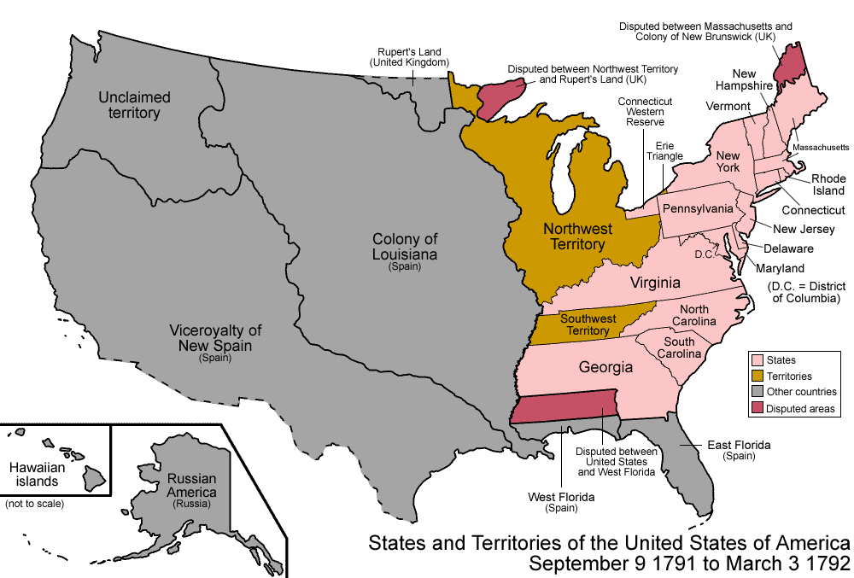
THE UNITED STATES IN 1791

