Slide 1
THE ELECTION OF 1860
By 1860 there was a widening gap between the North and South which ripped apart the Democratic party.
At the party convention in Charleston, South Carolina southern Democrats insisted that slavery be protected in the territories.
Stephen Douglas, the democratic candidate refused to abandon the principle of popular sovereignty.
The convention split = Northern delegates chose Douglas as their candidate.
Southern Delegates chose John C. Breckinridge (vice-president) as their candidate.
The Republicans now knew they had a good chance of winning = They chose Lincoln on the platform of limiting the spread of slavery.
The fourth party, the Constitutional Party nominated John Bell of Tennessee = compromise as a way of saving the Union.

Slide 2
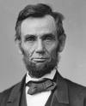
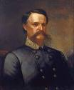
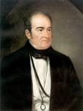
CANDIDATES OF 1860

Slide 3
RESULTS OF THE 1860 ELECTION
Lincoln and Breckinridge were seen as extremist.
-Lincoln = against extension of slavery
-Breckinridge – protecting slavery in the territories.
Douglas and Bell were moderates looking for a compromise.
The results made it clear the nation was no longer in the mood to compromise.
Lincoln won with 60 percent of the northern vote.
Breckinridge carried most of the South.
Douglas and Bell only did well in the border states.
Hysteria swept through the South = it was their ruin.
They feared a Northern majority in congress = 18 free states and 15 slave.
The South saw no choice but to secede – believing Lincoln wanted to end slavery altogether.

Slide 4
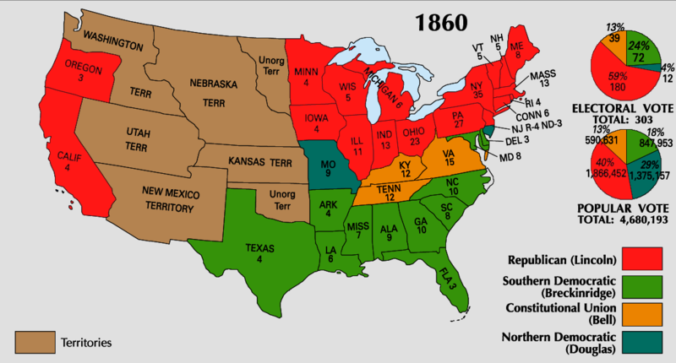
ELECTION RSULTS OF 1860

Slide 5
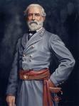
THE CIVIL WAR
On April 15, 1861, President Lincoln called on the states to provide 75,000 militiamen in 90 days.
North = volunteers hurried to sign
South = more states voted to secede.
Virginia = The South had a better chance with Virginia on its side. WHY?
-Wealth and Populous
Home to Robert E. Lee
In May of 1861, the Confederate Congress voted to set up its Capital in Richmond, Virginia -100 miles away from Washington D.C.

Slide 6
THE BORDER STATES
The border states would play a key role in the outcome of the war.
-The most important was Maryland. WHY?
If Maryland seceded D.C. would be cut of from the North.
Lincoln ordered the arrest of Maryland legislatures who supported the South.
-West Virginia = Federal troops helped some counties break away from Virginia, and formed West Virginia and joined the Union.
-Delaware and Missouri voted to join the Union.
-Kentucky = Declared it self neutral, than a Confederate invasion forced it to join the Union.
In the border stats families were pulled apart.
-Mary Todd Lincoln = four brothers and three brothers-in-law fighting for the South.

Slide 7
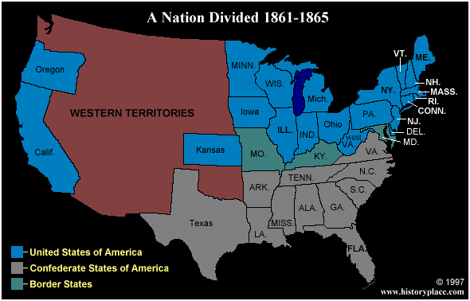
BORDER STATES

Slide 8
STRENGTHS AND WEAKNESSES
On the face of it, the Union had the hue advantage.
1. 22 million people to 9 million (3.5 million slaves)
2. The Union had most of the mineral deposits.
3. 86 percent of the factories were located in the North.
4. The North had 2 .5 times the railroad mileage. (21,700 miles to 9,000 miles)
5. Almost every ship in the Navy stayed with the Union (90 percent)
The biggest advantage for the Union was Lincoln. WHY?
-Able to convince northerners that the survival of democracy and freedom depended on preserving the union.
The Confederacy had its own advantage.
1. They began with better generals. (One-third of the career officers in the United States Army joined the Confederacy.)
2. They would be fighting a defensive war.

Slide 9
THE FIRST BATTLE
The two armies met for the first time at a stream called BULL RUN, near MANASSAS JUNCTION = a railway center 30 miles south of Washington D.C.
Union forces = 30,000
Confederates = 20,000
By midday the Confederates were driven back a mile.
The Confederate leaders rallied the troops = pointing a sword towards General Thomas J. Jackson
With the arrival of fresh troops the Confederates launched a countercharge
Attacking the Union line = the confederates let out a blood-curdling scream “REBEL YELL”
The Union troops, having reached their limits, scattered.
The retreating soldiers became entangled with the sightseers
THE FIRST BATTLE OF BULL RUN = Confederate Victory.
UNION = this was not the outcome they expected.

Slide 10
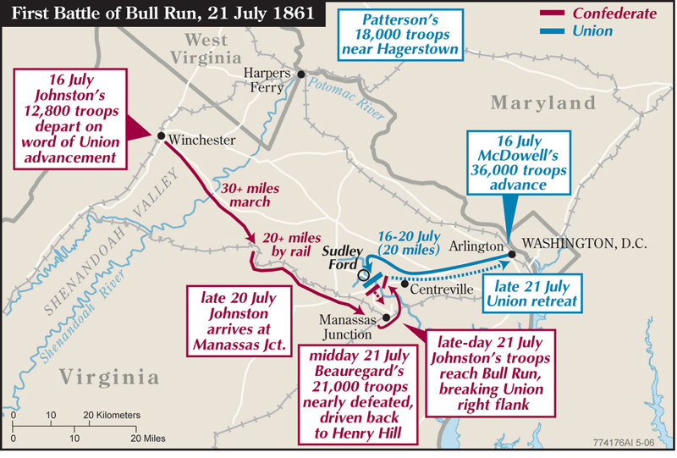
THE FIRST BATTLE OF BULL RUN

Slide 11
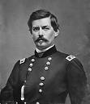
BULL RUN CONTINUED
The day after the battle Lincoln sent the 90-day militias home and called for a real army of 500,000 volunteers serving for three years.
Three days later he called for another 500,000
General George B. McClellan became the head of the army.
The news of Bull run electrified the South.
More educated Southerners realized they had won the battle, not the war.

Slide 12
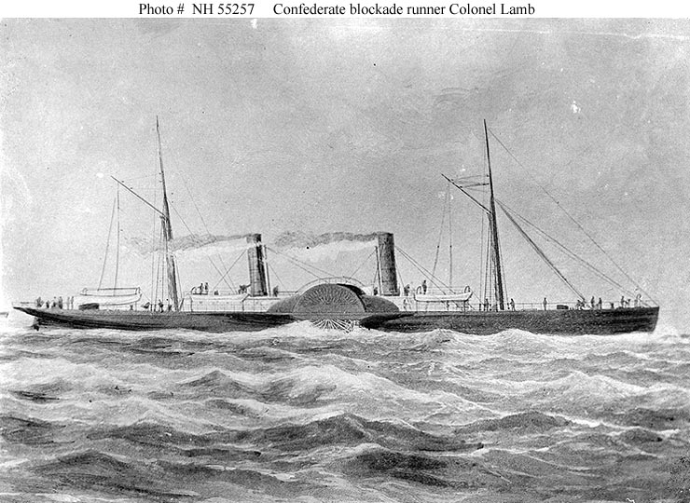
THE NAVAL WAR
The Union used its navy mainly for blockading the southern ports.
In the first year of the war the blockade was useless.
Soon Northern ship yards were building smaller faster gun-ships.
North = each cargo captured was split between the ship’s crew and the government.
As the Union captured more of the Confederate ports the blockade became easier.
April 1862 = The Union had control of almost every important Atlantic Harbor.
1864 = A blockade runner stood one chance in three of being captured.
1865 = It was one chance in two.

Slide 13
THE VIRGINIA AND THE MONITOR
The South’s desire to break the Northern blockade helped to produce the ironclad warship.
In 1862, the Confederates took the captured Union frigate (MERRIMACK) and refitted it with iron sides.
In 1862, the MERRIMACK now renamed the VIRGINIA, destroyed two wooden Union ships and ran another aground.
The following day the Union showed off its iron clad ship the MONITOR.
In the first fight between ironclad ships the VIRGINIA and the MONITOR fought each other for two hours.
Neither ship could sink the other and the battle ended in a draw.
The new ships did not play an important part in the war.
They were the forerunners for future navies.

Slide 14
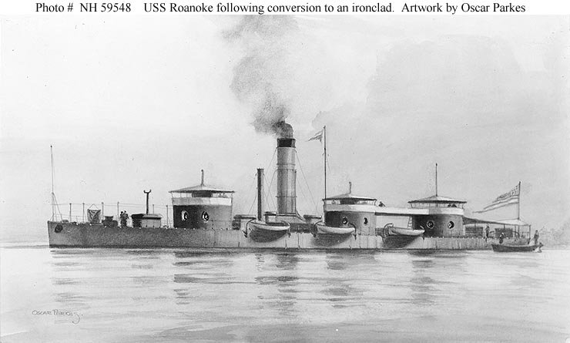
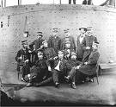
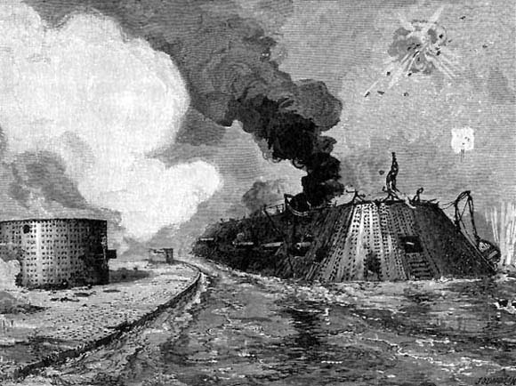
THE VIRGINIA AND THE MONITOR

Slide 15
THE CIVIL WAR CONTINUED
In the west in1862 General Grant for the Union captured Confederate river forts.
-Fort Henry on the Tennessee.
-Fort Donelson on the Cumberland River.
Grant began marching south and met the Confederate troops at THE BATTLE OF SHILOH in Tennessee.
This would be the fiercest fighting of the war to date.
General Johnston the confederate general was killed.
Union General William Tecumseh Sherman had three horses shot out from under him
General Pierre Beauregard took over as the Confederate General.
By the end of the day both sides believed they would win in the morning.
At night Union river boats brought fresh troops to Grant – at dawn Grant made a surprise attack forcing the southerners to retreat.

Slide 16
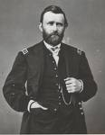
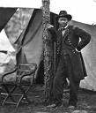
THE CIVIL WAR
On April 25, 1862 the city of New Orleans fell and was now in Union hands
Only 150 miles of the Mississippi River was now controlled by the Confederates.
Guarding this section was the fort at Vicksburg, Mississippi
Texas was able to with stand the Union attacks

Slide 17
TURNING THE TIDE OF WAR
Back in the east Jeb Stuart and Robert E. Lee won the SECOND BATTLE OF BULL RUN forcing Union troops to withdraw from Virginia to protect the capital of Washington D.C.
Lee decided to attack into the North to hopefully win the war to an end or at least for forcing Lincoln to leave the south alone.
Things did not start well for Lee.
A Confederate officer lost a copy of Lee’s battle plans and the Union found them.
McClellan now had his perfect chance to stop Lee.
The Union decided to attack.
The next battle occurred on September 17, 1862 at Antietam Creek near Sharpsburg, Maryland.
THE BATTLE OF ANTIETAM – it was the bloodiest battle of the war.
The two sides fought all day with neither gaining any ground = 23,000 dead or wounded.
Lee lost one-third of his army.

Slide 18
ANTIETAM CONTINUED
Although Antietam ended in a military draw it was a political victory for the Union.
-The British and the French still did not recognize the Confederacy.
-It gave Lincoln his chance to tell the nation about his new decision = EMANCIPATION PROCLAMATION (free the slaves)
The Emancipation Proclamation also declared that African American men willing to fight would be received into the armed forces.
African American had served I the navy, although the army rejected black volunteers.
African American regiments were led by white officers.
-usually paid less than whites
-black leaders urged African Americans to volunteer. WHY?
About 200,000 African Americans served in the Union Army and Navy.

Slide 19
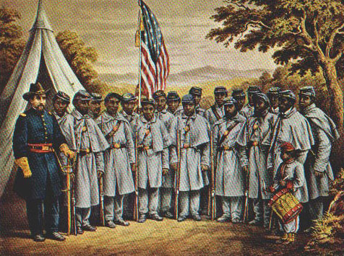
THE 54TH REGIMENT OF MASS.
Colonel Robert Gould Shaw

Slide 20
THE ROAD TO GETTYSBURG
Lincoln’s greatest frustration was finding a general who would attack Lee.
1. McClellan was out when he failed to go after at Antietam.
2. Ambrose Burnside lost his job after he was defeated in 1862 at Fredericksburg, Virginia
3. General Hooker lost to Lee at Chancellorsville, Virginia. Lee had half as many men .
By the summer of 1863 the Confederates seemed unstoppable and headed North to Pennsylvania.
Lee had two goals:
1. To get food and supplies for his army.
2. Lee hoped to force a peace settlement.
Even though the south was winning battles, the Northern blockade was destroying the South.
-What cost one dollar in 1861 = 1863 cost seven dollars.
-soldiers deserted to help their families survive
-riots broke out in Southern cities, looking for food.

Slide 21
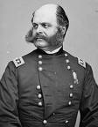
THE ROAD TO GETTYSBURG CONTINUED
The North was also growing tired of the war.
1. The number of volunteers declined, and congress was forced to start CONSCRIPTION, or a draft.
2. In July 1863,protesters against the draft battled police and soldiers in New York City.
3. More Northerners were listening to COPPERHEADS = northern Democrats who called for peace and a compromise with the South.
Lee believed a successful invasion of the North would encourage the Copperheads, and divide the North
-He also hoped the invasion would revive European interest in the South.

Slide 22
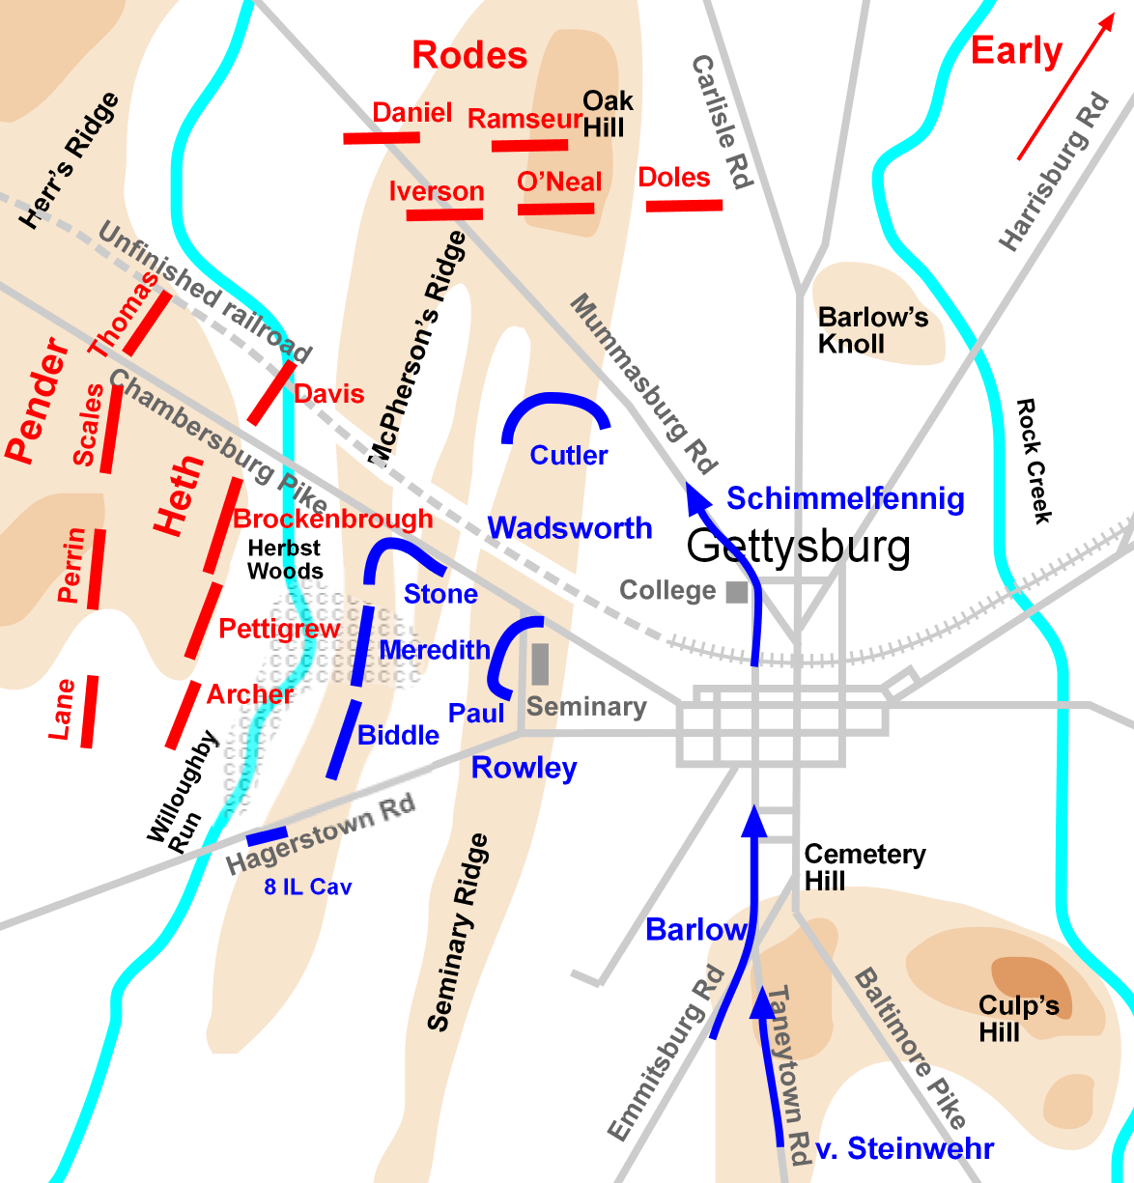
THE BATTLEOF GETTYSBURG
In late June 1863, Lee’s army crossed into the farmlands of southern Pennsylvania.
In a line parallel to Lee’s, the Army of the Potomac (Union) marched along the east side of the Blue Ridge Mountains.
Lincoln now believed this would be the time to defeat the South, although he was not sure he had the right general.
General Hooker was replaced with General George Meade.

Slide 23
GETTYSBURG CONTINUED
Morale had risen in the Army of the Potomac: Now the North was fighting on their own soil to protect their country.
Neither Meade or Lee planned on fighting at Gettysburg.
On July 1, 1863, Lee sent soldiers into Gettysburg to get supplies.
The Confederate soldiers stumbled upon Union soldiers and the BATTLE OF GETTYSBURG began.
The fighting lasted for three days – it was the greatest single battle of the Civil War.
The crucial part of the battle was PICKETT’S CHARGE.
1. for two days the armies held their positions on opposite ridges.
2. On day three Lee ordered General George Pickett to lead 13,000 men and attack the Union center on Cemetery Ridge.

Slide 24
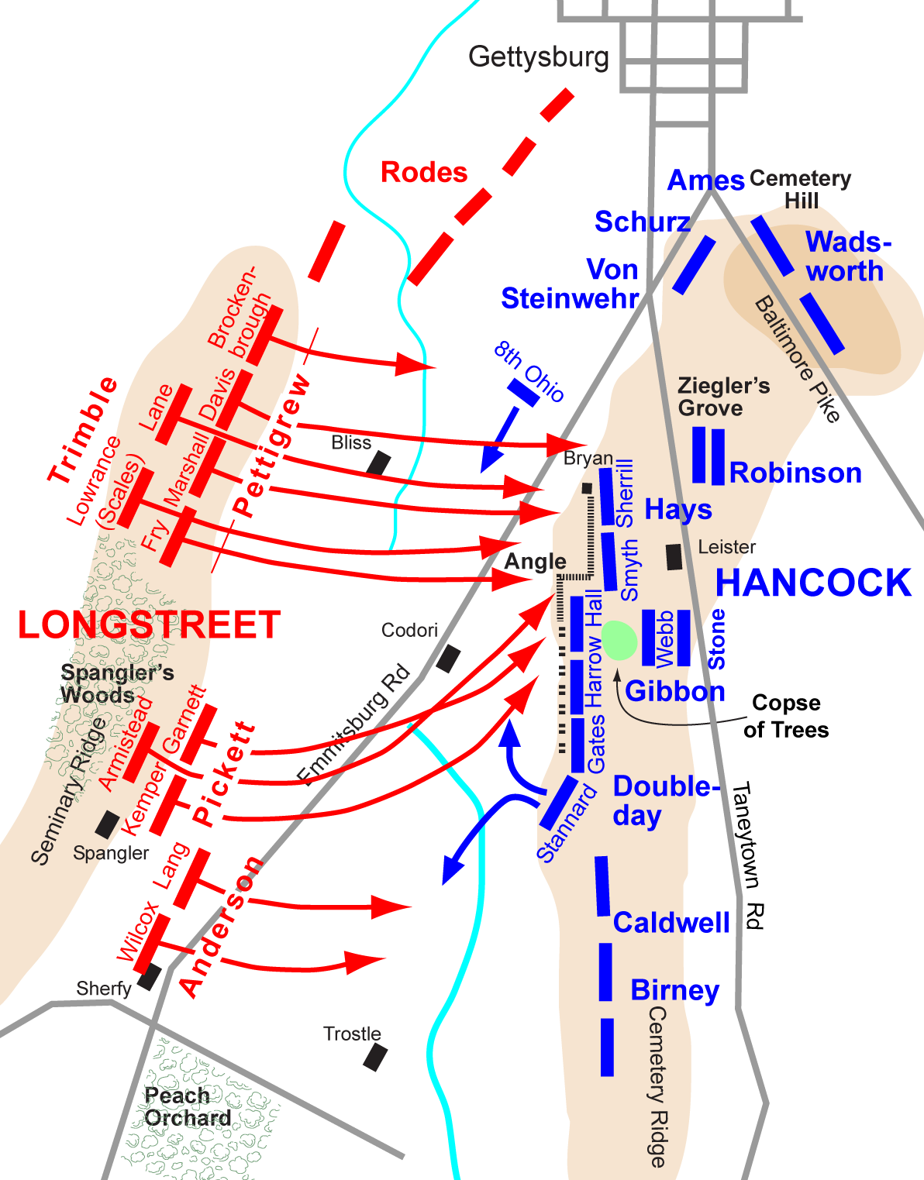
GETTYSBURG
3. Pickett’s Army had to cross a wide-open field to reach the Union Army.
4. During the charge Pickett lost half his army.
5. Some southern soldiers did make it across but could not hold the position.
6. Pickett’s charge ended the Battle of Gettysburg and Lee’s hope for victory.
7. The victory energized the North.
8. New technology helped the North to win = rifles, rifling
9. Lincoln was upset with Meade = did not finish off Lee’s Army

Slide 25
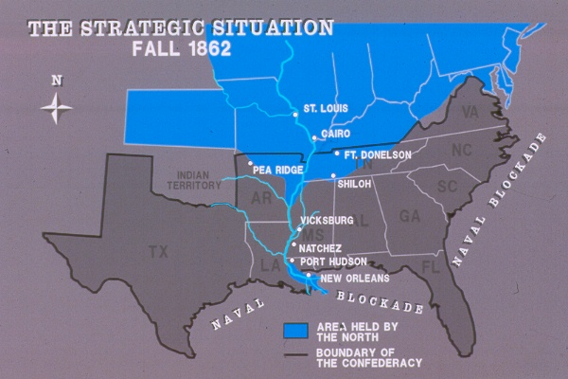
BATTLE OF VICKSBURG
On July 3, 1863, the same day of Pickett’s Charge, General Grant had taken Vicksburg after a three-month siege.
Vicksburg was more important than Gettysburg:
1. The Union had complete control of the Mississippi River.
2. The Confederacy had been cut in half.
3. Lincoln now had found his General (Grant)
4. It was all downhill for the confederacy.

Slide 26
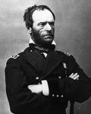
GRANT TAKES COMMAND
Late in 1863 Grant was put in command of the Union Armies.
Lincoln was impressed with his victories in the west and his ability to get things done.
In the spring of 1864, Grant was in Washington planning his attack on the Confederacy.
Grant himself would lead an army to pursue Lee.
Admiral Farragut would go after Mobile, Alabama = one of the few remaining ports in Confederate hands.
William Tecumseh Sherman was to move southeast from Chattanooga to Atlanta, Georgia.

Slide 27
SHERMAN’S MARCH TO THE SEA
Sherman took Atlanta in September 1864.
He then set out on a march to the sea – he cut a path of destruction through Georgia.
He left his supply trains behind, telling his men to live off the land.
He was the first American General to wage TOTAL WAR: A war designed to destroy not only enemy troops but also factories, fields, railroads, and livestock.
Sherman made no apologies.
“We are not only fighting hostile armies, but a hostile people, and must make old and young, rich and poor, feel the hard hand of war”.
In December of 1864, Sherman’s army reached the port city of Savannah, Georgia – leaving behind a devastating corridor 60 miles wide and 300 miles long.

Slide 28
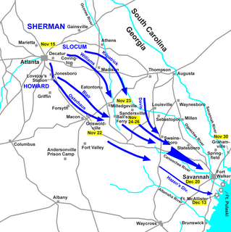
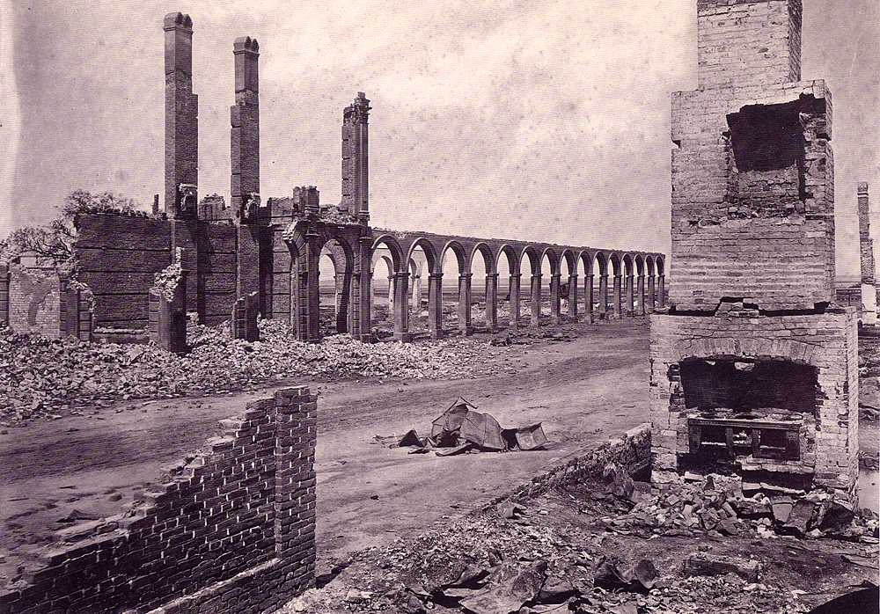
SHERMAN’S MARCH

Slide 29
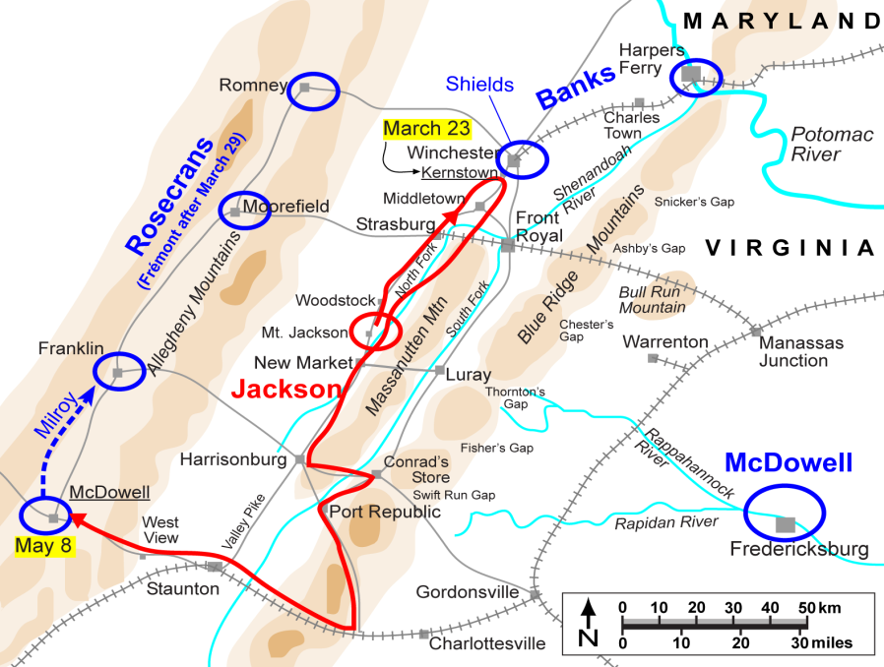
THE WAR ENDS
General Sheridan was doing the same type of damage as Sherman, although he was is the Shenandoah Valley = without this fertile region, Lee could not feed his troops.
By the spring of 1865 Grant has an army twice the size of Lee.
Grant = 120,000
Lee = 55,000
Sherman was north from Savannah.
Sheridan was ahead of Lee, trapping him.
Lee made the decision to surrender.
On April 9, 1865 in the Virginia town of Appomattox, in the courthouse, Lee and Grant arranged the terms of surrender.

Slide 30
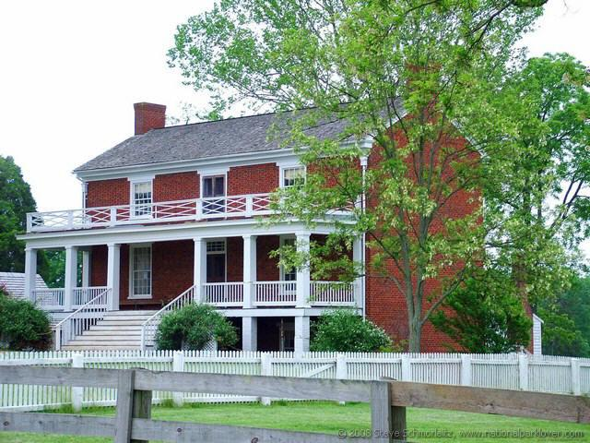
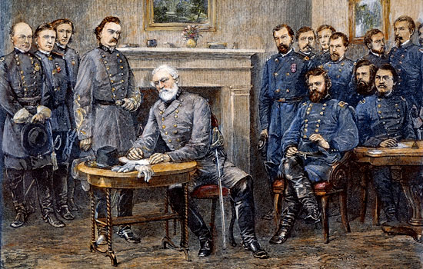
LEE’S SURRENDER

Slide 31
CONSEQUENCES OF THE WAR
The Civil War was the most devastating experience in the history of the U.S.
1. The Union was saved.
2. Slavery was ended.
3. The war lasted 4 years (1861-1865)
4. 620,000 men died:
-Union = 360,000
-Confederacy = 260,000
5. The war changed the way Americans thought about their nation = The nation itself was more important than the states.
6. The war helped the federal government expand – The new demands placed on the government made it necessary to grow.
-The first Federal Income Tax in 1861
-Built the Transcontinental R.R.
-Gave western land to settlers.
-Provided for state colleges
7. The war spurred industry – the war aided the growth of post-war industry.
-petroleum, steel, food processing, manufacturing, and finance.
8.The south was a disaster – rebuild the South and bring it back to the Union.

Slide 32
OTHER RESULTS
North = 275,000 wounded.
South = 138,000 wounded
Passing of the 13th, 14th, and 15th amendments.
13th = abolished slavery
14th = ex-slaves were now citizens of the U.S.
15th = could not be denied the right to vote because of race, color, or previous servitude.
The war produced over 1 million casualties (3% of the population)
Two-thirds of the deaths were because of disease.
8% of all white males (13-43) died in the war.
-6% for the North.
18% for the South.
Financial Cost:
North = 3.2 billion
South = 2. billion
Per Capita:
North = over 1,000
South = over 2,000

Slide 33
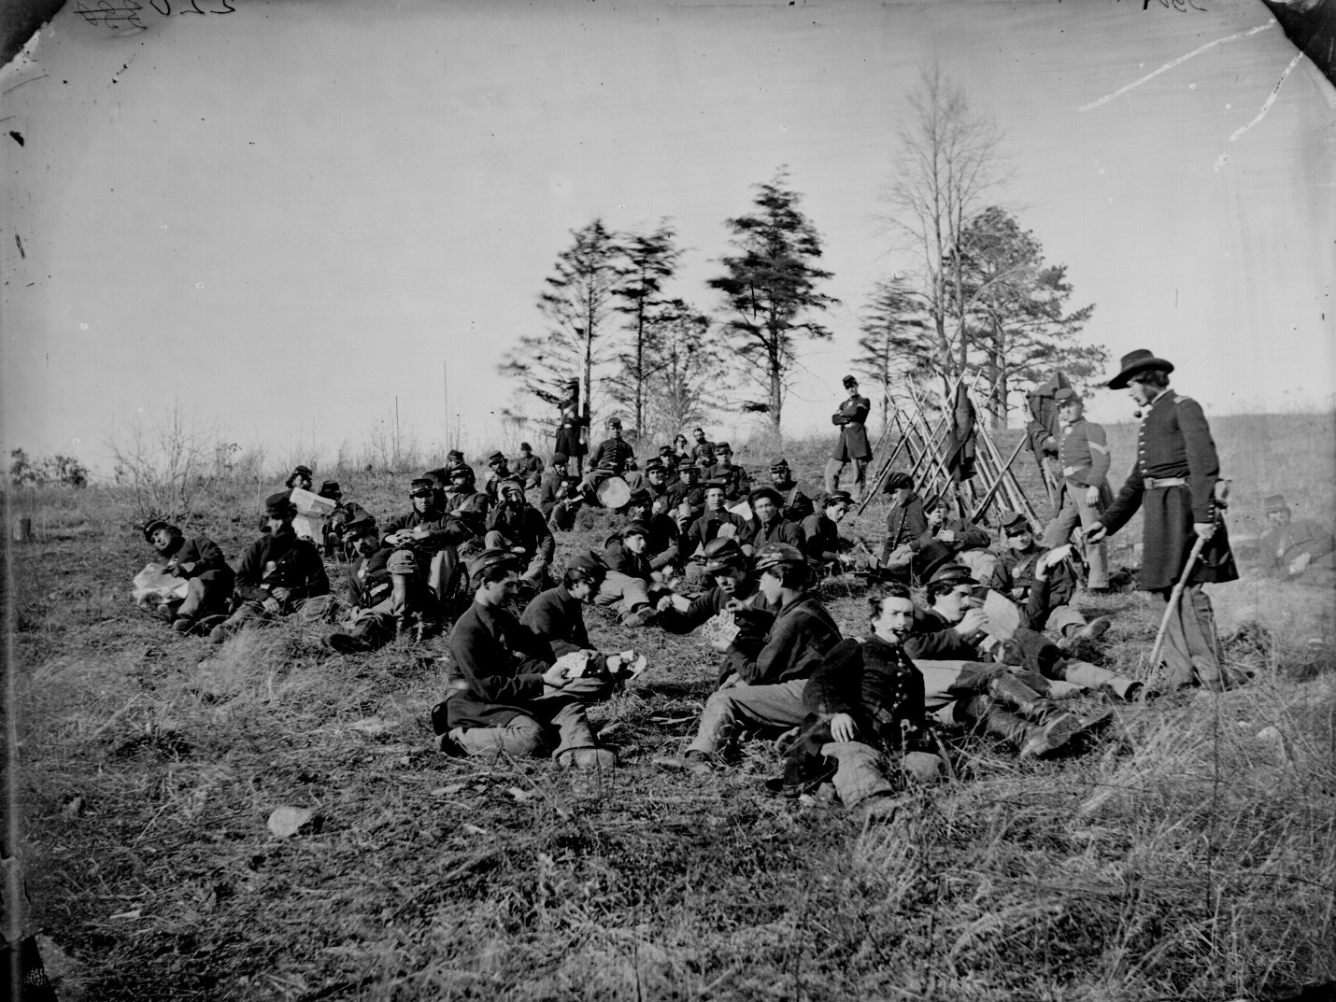
PICTURES OF THE CIVIL WAR

Slide 34
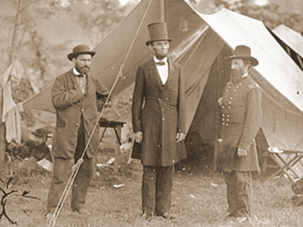
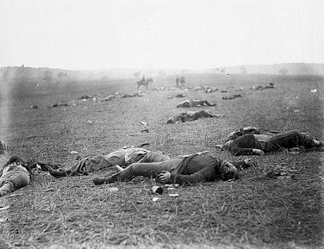

Slide 35
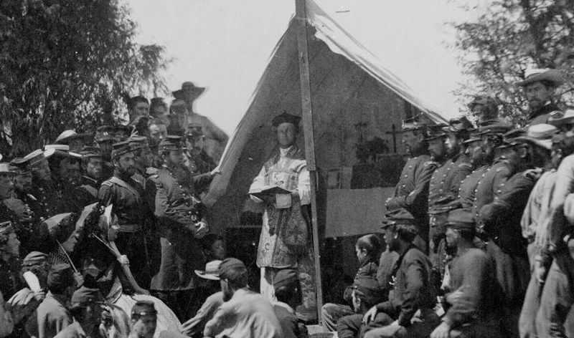

Slide 36
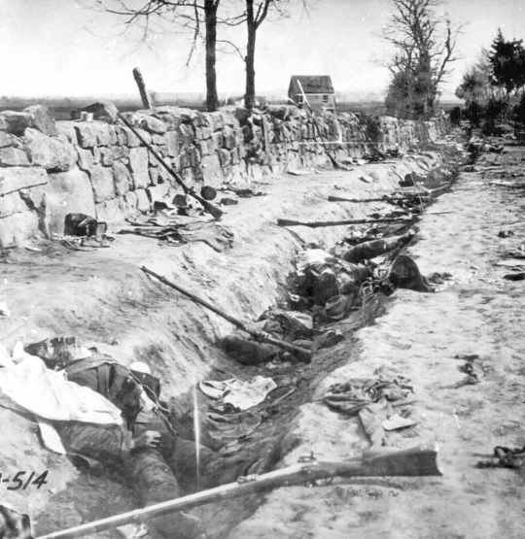
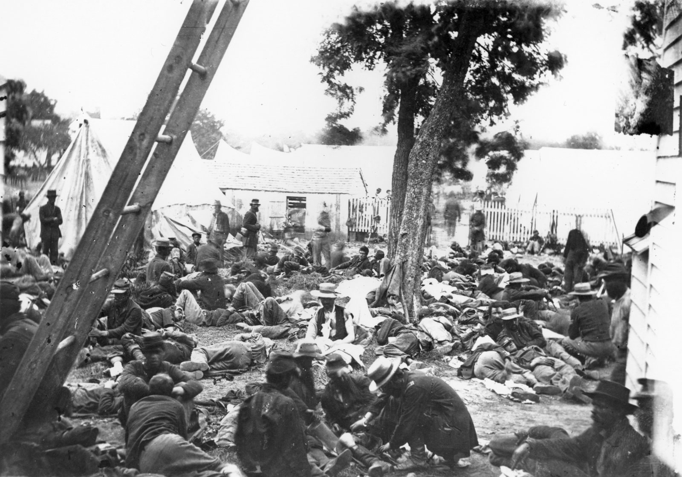

Slide 37
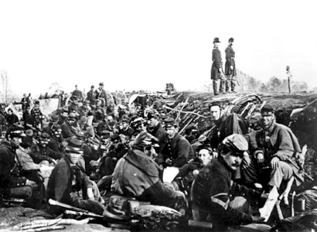
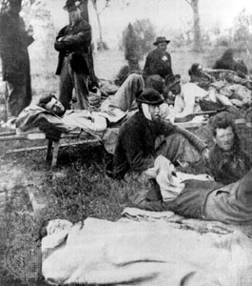

Slide 38
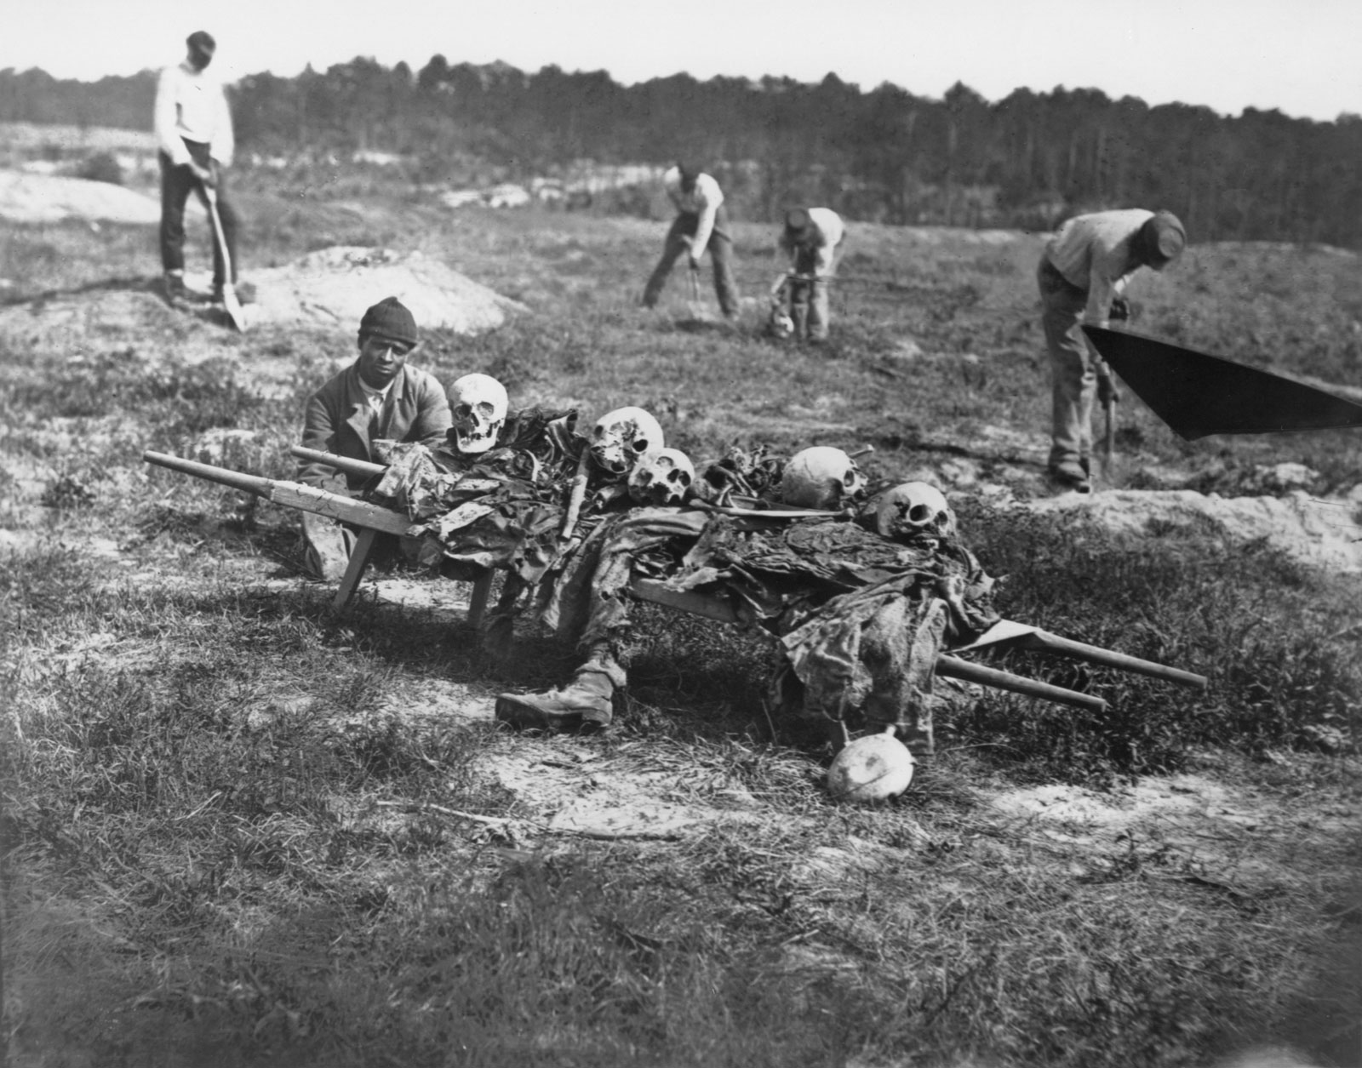

Slide 39
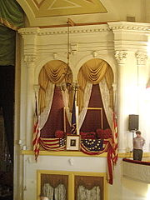
THE DEATH OF LINCOLN
Abraham Lincoln was assassinated on April 15, 1865 (Good Friday) while attending the play OUR AMERICAN COUSIN at Ford’s Theater.
Along with Lincoln was his wife, Mary Todd Lincoln, Major Henry Rathbone, and his wife to be, Clara Harris.
Lincoln’s assassin JOHN WILKES BOOTH, plotted with fellow conspirators, Lewis Powell and George Atzerodt.
Powell = Planned on killing Sec. of State Seward.
Atzerodt = Vice-President Andrew Johnson.

Slide 40
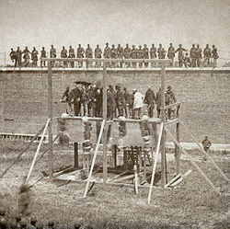
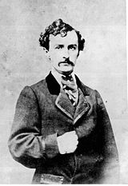
DEATH OF LINCOLN
Guard was gone
Booth was an actor, new the play, jumped to the stage.
Death to tyrants.
Rathbone stabbed
Petersen House
Three doctors
Booth fled and was helped.
Dr. Mudd
On the run till April 26th
Found in a barn belonging to Richard Garrett.

