Slide 1
THE ANTEBELLUM PERIOD
Antebellum = Latin for before war.
The dates of the period vary:
1. From the American Revolution to the beginning of the Civil War.
2. From about 1820 until the beginning of the Civil War.
The Antebellum Period consisted of the following:
1. A time of transition from a agricultural society to the industrial revolution.
2. Growth of slavery in the South.
3. The beginning of Westward expansion.
4.Transportation was expanded
5. Industry = interchangeable parts.
6. The American System (NATIONAL BANK)
7. Internal improvements
8. The Tariff

Slide 2
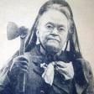
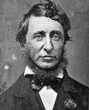
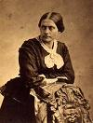
ANTEBELLUM CONTINUED
9. Religious revival:
-The Shakers
-The Mormons
-The Transcendentalist
-Oneida
10. Temperance
11. The Asylum
12. The Abolition Movement
13. Women’s Rights

Slide 3
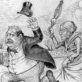
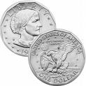
SUSAN B. ANTHONY

Slide 4
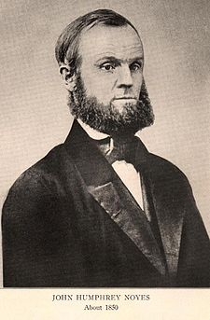
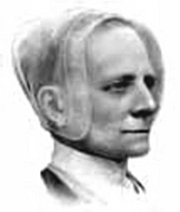
NOYES AND MOTHER ANN LEE

Slide 5
THE TEXAS TERRITORY
Mexico had gained independence from Spain and Texas became part of the Mexican Territory.
Mexico began to allow immigrants to come into the Texas territory and settle.
Stephen Austin was one of the first Americans to come into the territory and begin a colony – by 1825 there were 1,800 people living in the colony.
Mexico set two conditions for all immigrants to Texas.
1. Had to become citizens of Mexico.
2. Had to join the Roman Catholic Church.
Most new immigrants to Texas came from the cotton states.
By 1830 the population was about 10,000 – Anglo-Americans greatly outnumbered the Tejanos.
There were free blacks in Texas, although nine out of ten African Americans were slaves.

Slide 6
THE SANTA FE TRAIL
The Mexican government was becoming nervous about the outspoken and numerous Americans. WHY?
In 1830 the Mexican government closed the Texas frontier to Anglo-Americans and banned the introduction of more slaves.
Mexico was unable to stop Anglo-American population from growing – Illegal immigrants form the U.S. continued to go across the border into Texas.
As the population increased trade began to increase.
New Mexico was also open and a trail from the U.S. into Santa Fe, New Mexico opened used mostly for trading.
William Becknell who is considered to the father of the Santa Fe Trail was the first to use the Conestoga wagon (covered wagon or prairie schooner).
Each wagon carried up to 5,000 pounds = three pairs of oxen, horses, or mules were needed to pull the wagon.

Slide 7
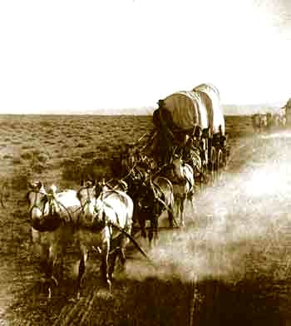
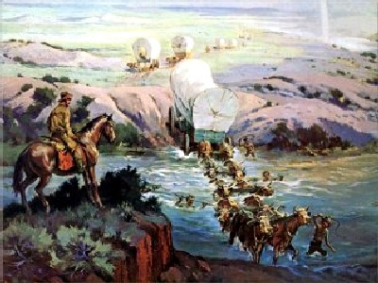
THE SANTA FE TRAIL CONTINUED

Slide 8
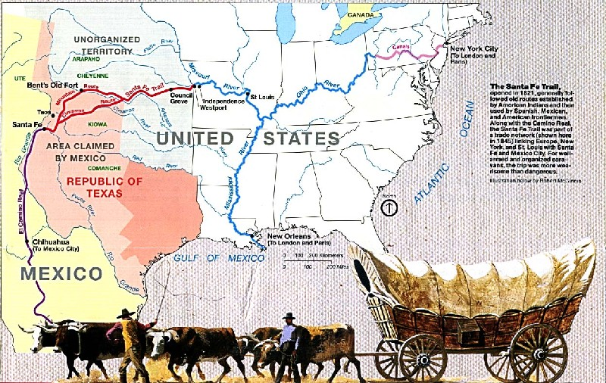
THE SANTA FE TRAIL

Slide 9
THE TEXAS REVOLUTION
Sam Houston who had been a member of the House of Representatives for Tennessee and also the governor of Tennessee moved to Texas in 1832.
He found Texas to be in a upheaval.
Texas was not a state by itself in Mexico.
Anglo-Americans were unhappy with certain laws.
1. Official documents had to be in Spanish.
2. Requirement to become Roman Catholic.
3. The ban on American immigration and the tariff on American goods.
Progress was being made on the laws.
In 1835 Santa Anna had become the dictator of Mexico.
Rebellions started in all parts of Mexico, although Santa Anna was able to stop them.
-he abolished federalism
-he overturned the constitution.

Slide 10
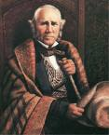
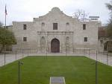
THE REVOLUTION CONTINUED
Santa Anna declared all Texans traitors.
War was now inevitable.
In October of 1835 a group of Texans declared themselves willing to fight to restore the Mexican constitution.
Santa Anna sent a army to San Antonio – the Texans drove the Mexican forces form the Alamo.
Santa Anna brought in a large force and the Texans scattered in small groups.

Slide 11
THE ALAMO
William B. Travis with about 150 men was able to hold the Alamo in the initial attack from Santa Anna.
-the force included such people as Davy Crocket and Jim Bowie.
Sam Houston was chosen to lead the Texan army because of his war experience(War of 1812)
On Feb. 23, 1836 Santa Anna was ready to attack – flew a red flag?
The siege of the Alamo began on Feb. 24, 1836.
On March 3, 1836 Texas leaders declared their independence.
On March 6, 1836 on the thirteenth day of the siege, Santa Anna ordered his men to go over the walls.
The Texans fought fiercely – hand to hand combat.
In the end 187 defenders of the Alamo were dead.

Slide 12
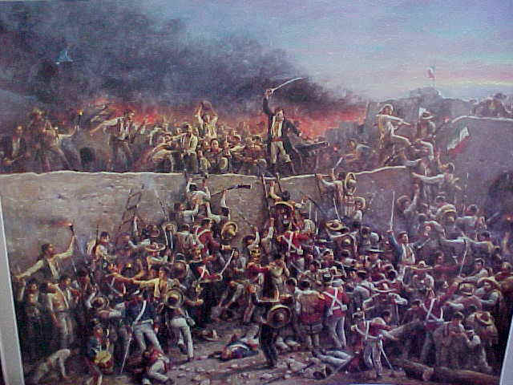
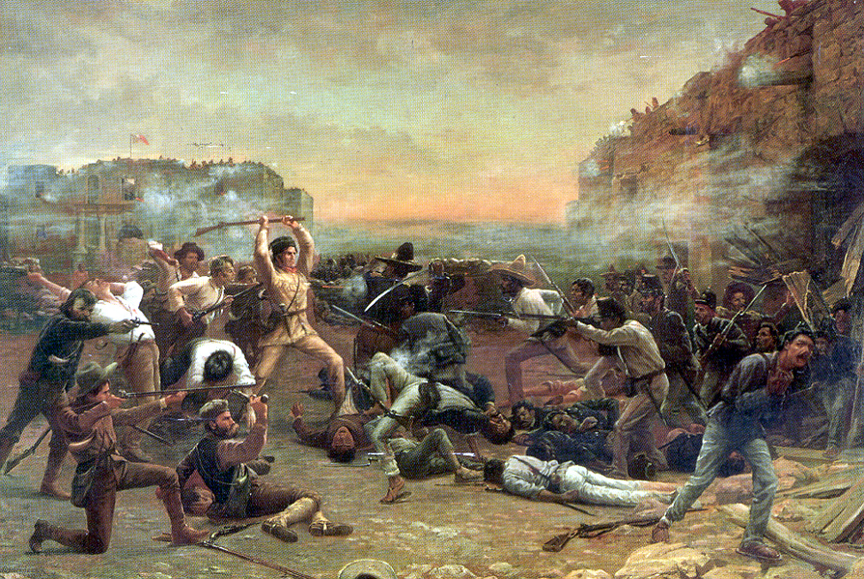
THE ALAMO

Slide 13
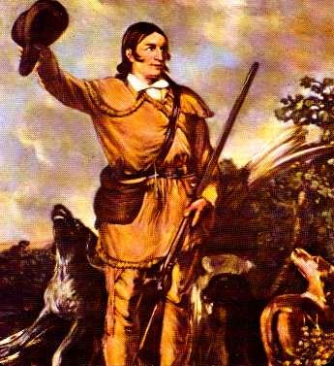
THE DEFEAT OF SANTA ANNA
Santa Anna’s victory at the Alamo was costly.
-1,800 Mexican soldiers were dead or wounded.
The Mexican officers learned that this could not be settled peacefully – they must conquer or die.
Santa Anna’s forces than defeated the Texans at another fortress (Goliad).
Santa Anna ordered them all killed.
More than 300 Texan prisoners were shot.
Next, Santa Anna needed to go after the remaining Texan forces led by Sam Houston.

Slide 14
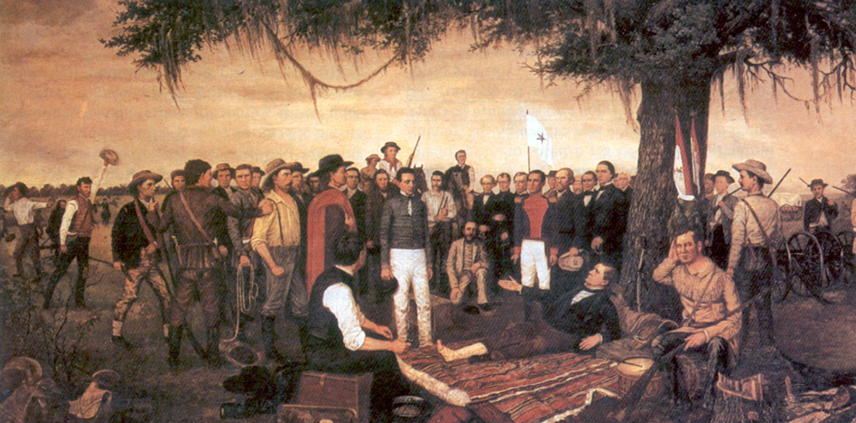
SANTA ANNA CONTINUED
Houston drew the Mexican Army into east Texas.
On April 21, 1836 Santa Anna expected Houston to attack at dawn – the attack never came.
By afternoon the Mexicans relaxed and many had fallen asleep.
Around four o’clock the Texans quietly advanced = the Texans attacked “Remember the Alamo”, “Remember Goliad”.
Santa Anna woke up with the camp in turmoil and the Mexicans were quickly defeated.
Santa Anna was captured, Texas won independence, and Houston became a hero and leader of Texas = BATTLE OF SAN JANCINTO.

Slide 15
THE LONE STAR REPUBLIC
December 1836 = Texas adopted a flag with a lone star, took the name THE LONE STAR REPUBLIC, proclaimed Texas to be an independent, self governing country.
Sam Houston became the first president.
Austin became the capital.
Most Texans planned on joining the U.S.
In 1836 Texas asked to be annexed. Why?
The U.S. refused. Why?
Texas would remain and independent republic for another ten years.

Slide 16
NATIONAL EXPANSION
In the election of 1844 Henry Clay ran for the Whigs. The Democrats nominated James K. Polk.
Polk believed that annexation of Texas was a necessity and a right.
Polk also urged for the occupation of Oregon “Fifty-four forty or fight”.
The parallel of 54 degrees 40’ was the northern boundary of the Oregon Country.
Acquiring Oregon, California, and Texas was the nation’s MANIFEST DESTINY.
Polk barely won the election – he negotiated with Britain over Oregon and agreed to divide Oregon at the 49th parallel.
This was the boundary between Canada and the U.S. from the Great Lakes to the Rockies.

Slide 17
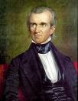
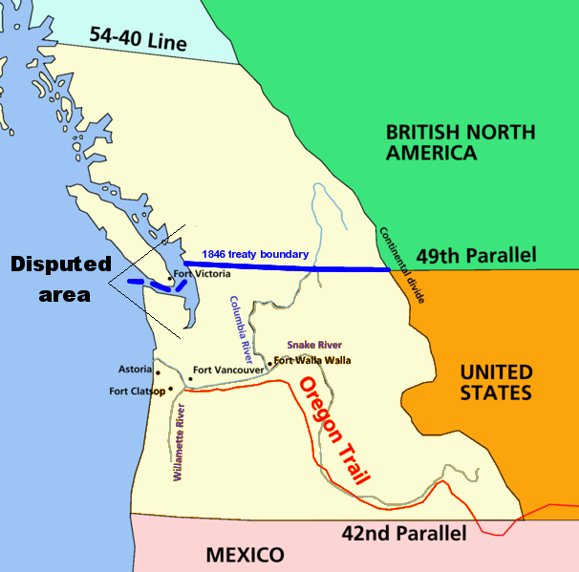
NATIONAL EXAPNSION

Slide 18
MEXICO
After Polk’s election congress voted to annex Texas (December 1845) – Mexico was outraged.
Things grew worst when Texas claimed the Rio Grande as its southern boundary.
Polk tried to negotiate with Mexico – Mexican officials refused to meet.
In 1846 a new Mexican government came to power and insisted that the Mexican territory included all of Texas.
Mexico announced they were ready to go to war to defend it.
Polk had sent General Zachary Taylor to guard the territory – he positioned himself near the Rio Grande in the Texas territory.
Mexico regarded this an act of war.
A Mexican force crossed the river and attacked the American troops.
Polk told congress “Mexico has invaded our territory and shed American blood upon American soil”.
In May of 1846 the U.S. declared war on Mexico.

Slide 19
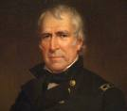
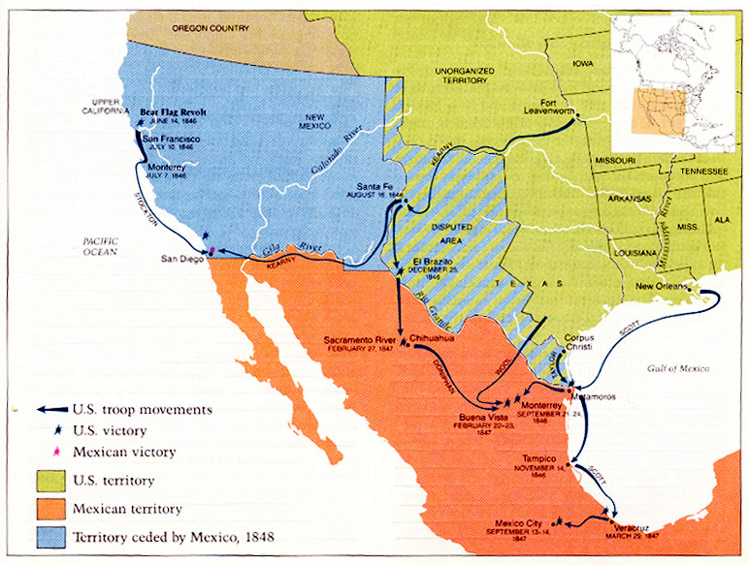
WAR WITH MEXICO

Slide 20
WAR WITH MEXICO
Most Americans in the South and West agreed with the war. In the Northeast many people denounced the war. WHY?
In the summer of 1846 Stephen Kearny took an American force from Kansas and headed for New Mexico.
The New Mexicans were afraid that the Americans would destroy everything – Kearny promised to protect their rights.
The Americans took Santa Fe and New Mexico without firing a shot.
Kearny then headed for California.
In California, a group of Americans rebelled against Mexican authority – arrested General Mariano Vallejo = BEAR FLAG REVOLT. *
Americans made a flag showing a grizzly bear.
John C. Freemont was one of the promoters of the rebellion (married to a senators daughter, the senator promoted expansionism)
The inhabitants of Los Angeles rebelled against American rule and forced them out.
Forces under Fremont and Kearny retook the city.

Slide 21
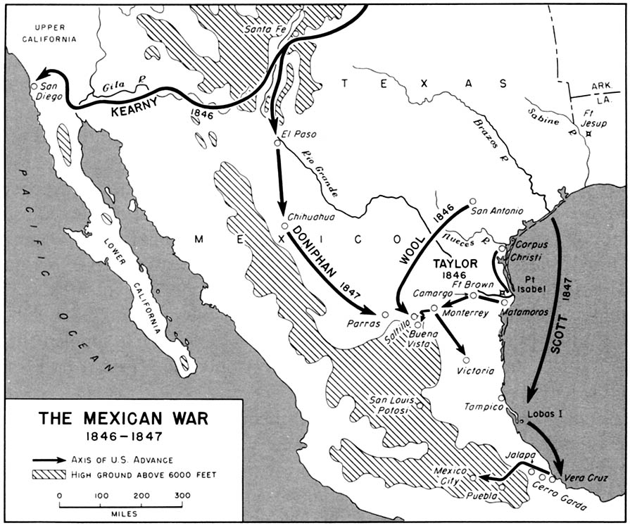
INVADING MEXICO
U.S. forces invaded Mexico from two directions.
1.General Taylor moved south from Texas – defeating Santa Anna’s troops at Buena Vista in Feb. 1847.
2. General Winfield Scott landed at Veracruz and battled inland toward Mexico City.
Scott met great resistance from defenders of Chapultepec (national military school)
-1,000 soldiers and 100 cadets fought to the death.*

Slide 22
THE WAR COMES TO AN END
Mexico City fell to Scott’s troops in September 1847.
The war ended with the TREATY OF GUADALUPE HIDALGO in 1848.
1. Mexico recognized the Rio Grande as the Southern boundary.
2. Mexico ceded New Mexico, California and the land between them.
-MEXICAN CESSION = California, Nevada, Utah, parts of Arizona, New Mexico, Colorado, and Wyoming.
3. The U.S. paid Mexico 15 million in cash.
The U.S. also paid 3.35 million dollars to Americans who claimed that the Mexican government owed them money.
The war cost the U.S. 100 million dollars, 17,000 dead or wounded.
Many officers had their first experience in war = Robert E. Lee, Ulysses S. Grant, Jefferson Davis.
Mexico = 25, 000 died in combat, lost one half of its territory.
GADSEN PURCHASE = Mexico sold the U.S. a strip of land for 10 million (southern New Mexico and Arizona)*
Santa Anna banished in 1855.

Slide 23
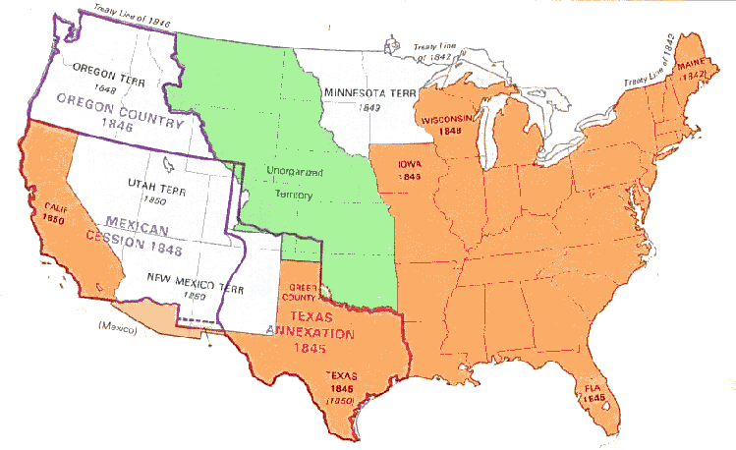
NEW TERRITOREIS

