Slide 1
THE ELECTION OF 1800
By 1800 parties had formed, in the election there were the:
FEDERALIST = thought that the nation was about to be undone by non-religious radicals(FRENCH REVOLUTION)
REPUBLICANS: saw themselves as saving the nation from tyranny and monarchy.
Returns = Jefferson defeated John Adams 73-65.
PROBLEM = According to the constitution, the electors cast two votes for president:
1.person with the most/majority becomes president.
2. person with the second largest/majority becomes vice-president.
Jefferson = Republican
Adams = Federalist
Jefferson = 73 and Adams = 65(WHO WON?)

Slide 2
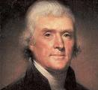
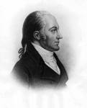
ELECTION OF 1800 CONTINUED
Aaron Burr
Republican = 73
According to the constitution = the House of Representatives would have to break the tie.
The Federalist held a majority in Congress.
The Federalist, not the Republicans would decide.
The Federalist were divided:
1. some feared Jefferson
2. they knew the public supported Jefferson
The House tied on 35 ballots.
On the 36th ballot, three Federalist gave their support to Jefferson(help from Hamilton)
Jefferson=President, Burr=V.P.

Slide 3
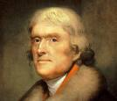
THOMAS JEFFERSON
Wrote the Declaration of Independence.
Ambassador to France
Secretary of State under Washington
Leader of the Republican Party
Vice President under John Adams
A Lawyer
Architect = Inspired by classical Greek and Roman buildings.
Designed his home = MONTICELLO

Slide 4
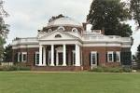
JEFFERSON CONTINUED
MONTICELLO:
He invented the :
1. Dumbwaiter
2. Storm windows
3. Seven-Day Clock:

Slide 5
MORE JEFFERSON
Jefferson worked closely with the architects and designers of Washington D.C.
He was a musician who loved to play the Violin.
Loved to read = one of the best libraries in America.
His library became the core of the LIBRARY OF CONGRESS.
Considered to be a GENTLEMAN FARMER?
He disagreed with the idea of a strong, active government.
He believed the federal government should have a limited role in people’s lives.
At a dinner honoring Nobel Prize winners in 1962, President Kennedy said:
“I think this is the most extraordinary collection of talent that has ever been gathered at the White House, with the exception of when Thomas Jefferson dined alone”

Slide 6
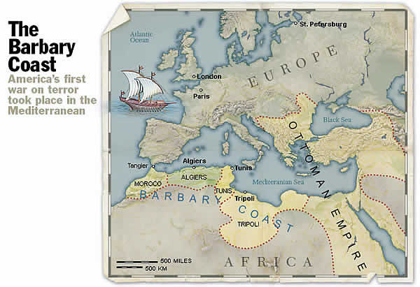
AGAINST PIRACY
To Jefferson, a small government did not mean a weak government.
At the time the United States enjoyed healthy trading with Europe.
Shipping goods on the Mediterranean Sea involved risk.
Pirates from the Barbary Coast (Morocco, Algiers, Tunis, and Tripoli) preyed on merchant ships.

Slide 7
PIRACY CONTINUED
American and European governments had paid tribute to the Barbary Pirates to leave their ships alone.
Jefferson saw this as weakness and an insult.
In 1800 the ruler of Tripoli demanded more protection money from the U.S.
In 1801 Jefferson sent a fleet of warships to the Mediterranean to protect American merchant ships.
For the next four years, America’s navy fought the pirates.
In 1804, Stephen Decatur led a bold raid against the American Ship, the PHILADELPHIA, which earlier Barbary pirates had captured.
Decatur’s crew burned the ship.
The following year the Barbary rulers signed a treaty with America not to interfere with American shipping.
In 1815 = Britain and Holland did the same.
The pirate kingdoms collapsed.

Slide 8
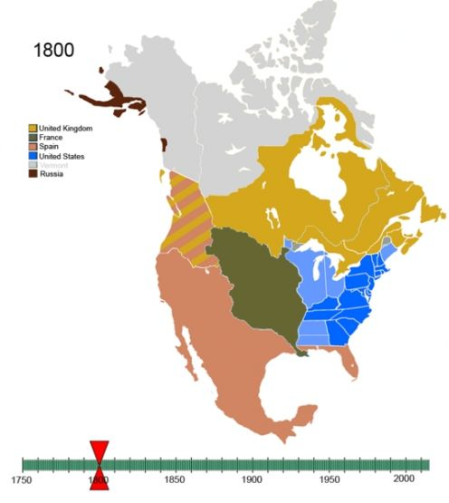
THE PACIFIC COAST IN 1800
At one time Spain controlled the entire Pacific Coast:
1. In the 1740s Russia set up trading post on the Alaskan coast/seals – They slowly moved into the Pacific Northwest.
2. This forced Spain to begin settling Upper California.
-They set up missions.
-Los Angeles, Monterey, San Jose, and San Francisco.
3. The British Canadians were pushing westward: In 1793 Alexander MacKenzie became the first white man to cross North America on land.
-The British now claimed the Pacific Northwest.
In 1792 Captain Robert Gray discovered the river that divides the states of Washington and Oregon.
-He named the river “Columbia” after his ship.
-He claimed the region for the United States.
New Englanders were now trading there.

Slide 9
AMERICANS MOVE WESTWARD
By 1800 Kentucky and Tennessee were both states.
In 1803 Ohio entered the Union.
The concerns of the west and south were becoming more important.
By 1800 one-third of the of American trade was with the West Indies.
The most important market was HISPANIOLA.
-France controlled the western half of the island(Haiti).
-Spain controlled the eastern half (Dominican Republic)
-The French Colony was the jewel of the French Empire.
The French Revolution caused problems on French Hispaniola.
1. Slaves rebelled in 1791, by 1793 they seized Haiti and declared their freedom.
2. There were also revolts on the Spanish section, by 1801 the slaves had taken over the island.
3. This news made slave owners in the United States nervous.
4. When Napoleon asked Jefferson for help in putting down the rebellion, he said yes (nothing occurred).

Slide 10
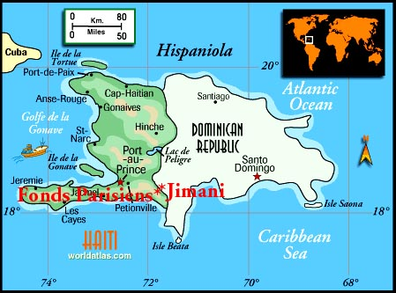
FRANCE AND THE U.S.
Napoleon had larger plans:
1. In 1800 France signed a secret treaty returning Louisiana to France.
2. He was going to re-establish white rule on Hispaniola.
3. Occupy Louisiana.
4. France would not allow American ships on the Mississippi to leave through New Orleans.
5. Jefferson wanted to keep neutrality, yet protect the rights of Americans.

Slide 11
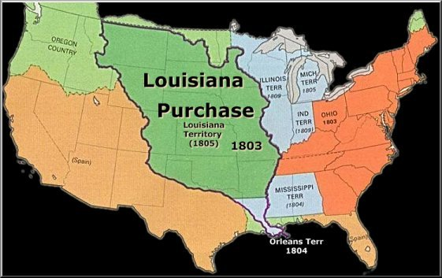
FRANCE AND THE U.S. CONTINUED
Jefferson sent ministers to France with an offer to buy New Orleans.
THREAT = If France takes possession of New Orleans the U.S. will become allies with Britain.
France was still fighting the rebellion on Hispaniola, a French Army of 34,000 was sent to crush the rebellion = fighting and disease reduced the force to 4,000.
Napoleon decided to withdraw from Hispaniola and sell Louisiana.
LOUISIANA PURCHASE = In 1803 the U.S. bought Louisiana from the French for 15 million dollars.
The purchase doubled the size of the U.S.

Slide 12
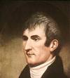
THE CORPS OF DISCOVERY
Thomas Jefferson had dreamed of an expedition to explore beyond the Mississippi.
As president he now recruited Meriwether Lewis (officer in the army – knowledge of geography and the outdoors)
Together they began to plan the trip. (CORPS OF DISCOVERY)
This would be the first American Scientific Expedition = return with detailed information about the land, the plants, the animals, and the native people.
Lewis needed a partner to help oversee the expedition.
He asked WILLIAM CLARK = mapmaker, outdoorsman, and a leader.
CORPS OF DISCOVERY = LEWIS AND CLARK EXPEDITION.

Slide 13
LEWIS AND CLARK
Accompanying Lewis and Clark was Clark’s African-American servant, York.
He was a large, strong man skilled at hunting and very good at communicating with the native population.
He was the first black man that most Native Americans ever saw – he became a celebrity among the western Indian nations.
The expedition set out in the summer of 1803 and by the winter reached St. Louis.(an outpost with about 180 houses.
Lewis and Clark spent the winter at St. Louis waiting for the transfer of Louisiana from the French to the U.S.
In May of 1804 the expedition of 40 men headed up the Missouri River.
In late October they reached what is now North Dakota – wintered in this area.
In the Spring of 1805 the company set out again – now with a Frenchman named Toussaint Charbonneau, his wife Sacajawea(Shoshone Indian), and their baby.

Slide 14
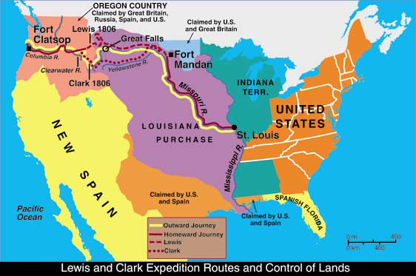
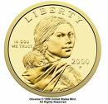
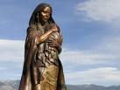
LEWIS AND CLARK CONTINUED
Lewis and Clark planned on Sacajawea to be their interpreter when they reached the Rocky Mountains (Shoshone Land).
At Shoshone land the expedition reached the headwaters of the Missouri River.
The Shoshone chief recognized Sacajawea – his sister.
Shoshone guides took the expedition by horseback to the Snake River
They took the Snake to the Columbia River which empties into the Pacific Ocean (November 1805)
In the Spring they returned.

Slide 15
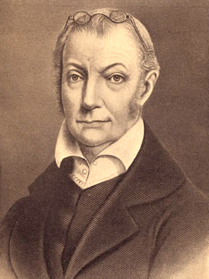
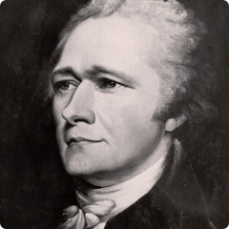
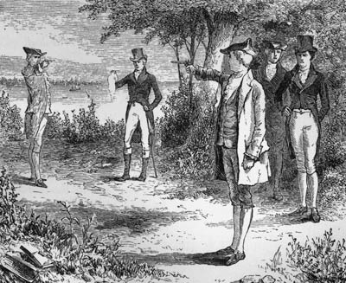
ZEBULON M. PIKE
In 1804, while still Vice-President, Aaron Burr challenged Alexander Hamilton to a duel. WHY?
Burr killed Hamilton.
He was formally charged with murder, although he remained vice-president until his term ended in 1805.
After leaving office, Burr had a plan to rule Louisiana and to seize Mexico from Spain.
He needed more information about New Spain – Burr worked with James Wilkinson, governor of the Louisiana Territory (double agent).
Expedition = find the headwaters of the Red River (boundary between New Spain and Louisiana)

Slide 16
PIKE CONTINUED
Zebulon M. Pike was put in command of the expedition.
1.make treaties with the American Indians.
2.Collect scientific information.
3.Report on the defenses on New Spain’s northern frontier.
Pike’s party of two dozen left St. Louis and headed westward across what is now Kansas.
Pike followed the Spanish trail to the Southern Rockies, where he could now see the peak that has his name.
Pike’s party headed into the mountains, in the winter = hunger, frostbite, death.
He set up a small camp near the upper Rio Grande.
Pike was in Spanish territory, he was arrested and taken to Mexico for questioning(This is what he wanted. Why?)
The next year he was released in American Territory.
He never came close to the Red River.
His expedition provided the first accountant in English of the Great Plains and the Rio Grand Valley.

Slide 17
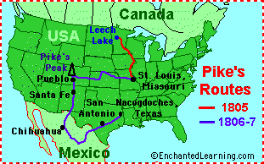
PIKE CONTINUED
Burr and Wilkinson failed in their attempt to control Louisiana and Mexico.
Wilkinson betrayed Burr to Jefferson.
Burr was tried for treason, although found not guilty.
Pike was cleared of any involvement.

Slide 18
DRIFITING TOWARD THE WAR OF 1812
The steps leading to the War of 1812 started on the high seas.
1. 1803 – France and Britain were at war.
2. Each was trying to prevent the other from getting food and supplies.
3. Both countries seized American ships sailing towards the enemy’s ports.
4. Britain also increased IMPRESSMENT.
Jefferson was now re-elected in 1804 for a second term.
He wanted to avoid war, although American shipping rights were at risk.
The U.S. passed the EMBARGO ACT OF 1807 = banned American ships from sailing to any foreign ports
-closed American ports to ships from other countries.
It did not work. WHY?
The embargo became a major issue in the election of 1808.
1.Jefferson declined to run again,
2. James Madison ran for the Republican party and won.
3. The embargo was causing the Republican Party to lose popularity.

Slide 19
DRIFITING TOWARDS WAR CONTINUED
The Embargo Act was replaced with the NON-INTERCOURSE ACT OF 1809 = Americans could trade with any country except France and Britain.
This did not work any better than the embargo.
Americans were becoming more warlike, especially towards Britain.
Calls for war came mainly from westerners. WHY?
In the west land was becoming the issue.
Native Americans were beginning to rebel because of land being loss.
One of those leading the rebellions was TECUMSEH = the son of a Shawnee chief.
He also has help from his brother known as the PROPHET (shaman)
The headquarters of Tecumseh was Prophetstown – located on Tippecanoe Creek in central Indiana.

Slide 20
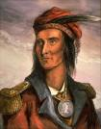
TECUMSEH CONTINUED
To better understand the white culture Tecumseh learned English, read the bible, Shakespeare, and history books.
He understood that the Indians needed to do what the whites did: unite.
In 1809 William Henry Harrison (Governor of the Indiana Territory) persuaded some tribes to sign a treaty = sell 3 million acres of land in Indiana/one-half cent per acre.

Slide 21
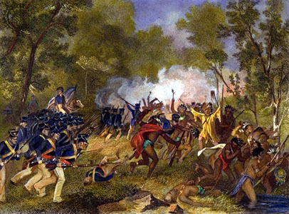
TECUMSEH’S ACTIONS
Tecumseh declared that the treaty was meaningless and convinced others.
Tecumseh traveled from the Gulf Coast to the Great Lakes urging Indians to form a confederation.
In 1811, Tecumseh traveled south of Ohio to gain support.
Harrison marched with 1,000 troops toward Prophetstown.
On November 7, 1811 a battle broke out - Harrison defeated the Indians and the next day burned their village.
This is the BATTLE OF TIPPECANOE = It destroyed Tecumseh’s dream of an Indian Confederation.

Slide 22
THE WAR HAWKS
Harrison blamed the British for helping Tecumseh and encouraging Indian unity.
-The British had nothing to do with it.
-After the Battle of Tippecanoe, Tecumseh and his warriors were welcomed in Canada.
-The British and Indians became allies.
This caused greater anti-British feelings on the frontier.
Western leaders such as Henry Clay from Kentucky called for war.
These westerners were called = WAR HAWKS.
1. They wanted British aid to the Indians stopped.
2. They wanted the British out of Canada.
Congress declared war on Britain on June 18, 1812.
1. the impressment of American Sailors.
2. violations of American rights at sea.
3. British encouragement of the Indians.

Slide 23
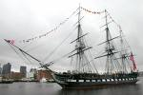
THE WAR OF 1812 – PHASE ONE
The War of 1812 had two phases:
1. Phase one 1812-1814 = Britain was still focused on France and Napoleon.
-Britain fought a limited war in America.
-Britain defended Canada from America .
-Hit and run raids along the coast.
-Blockade of American ports.
American efforts on the ground usually met with failure.
The American Navy was successful.
1. The navy had experience fighting the Barbary Pirates.
2. The Navy’s frigates were the fastest around. (Constitution, United States, President)

Slide 24
LAKE ERIE
The most important naval victory took place on Lake Erie.
1. The U.S. built a fleet of ships on the shore of Lake Erie.
2. The man in charge of the fleet was Oliver Hazard Perry.
3. In September of 1813 a British fleet was ordered to destroy the American fleet.
4. Perry sailed out to meet the British
-Perry flew a banner:
DON’T GIVE UP THE SHIP
5. The two sides fought for two hours.
6. Perry’s ship was destroyed, he grabbed the banner, jumped in a rowboat with five others and rowed to another ship.
7. Took control of that ship and destroyed two British ships.
“WE HAVE MET THEY ENEMY, AND THEY ARE OURS”
Perry wrote this to William Henry Harrison, waiting on the shore of Lake Erie in Ohio.

Slide 25
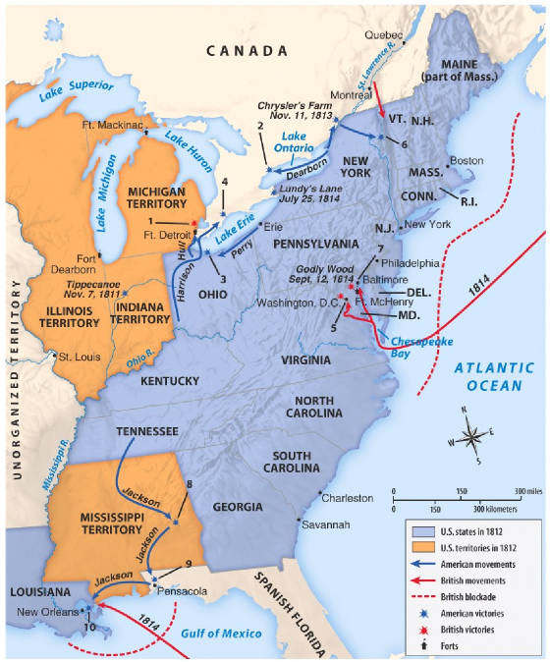
LAKE ERIE CONTINUED
Harrison was waiting with an army of 3,000 – he ferried his army across Lake Erie to Detroit.
The British had retreated into Canada – Harrison followed.
At The Battle of the Thames in October 1813 = Harrison defeated the British and their Indian allies.
Tecumseh was one of the dead.

Slide 26
THE SECOND PHASE
The British defeated Napoleon in 1814 – now they could turn their full attention to the Americans.
British Plan = Attack the United States from the south (New Orleans) and the north (Canada), and have hit-and-run attacks on American ports.
In August of 1814 the British sailed into Chesapeake Bay, the British marched overland towards Washington D.C.
The British overpowered the thousand soldiers protecting the capital.
As the British entered government officials fled from the other side.
The British torched public buildings including the White House and Capitol.
This was revenge for an American attack on York in Canada where Americans burned government buildings.
The next day a hurricane struck – when it was calm the British took out their ships.

Slide 27
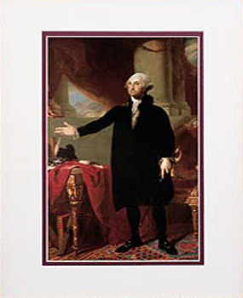
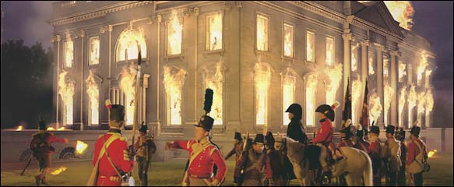
THE BURNING OF THE WHITE HOUSE

Slide 28
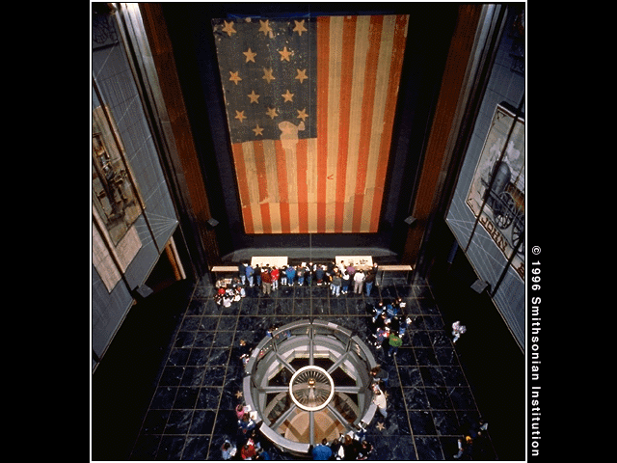
FORT McHENRY
The next attack by the British came at Fort McHenry in Baltimore.(1814)
The fort’s commander requested a flag big enough that the British would not have any problem seeing it. (42 by 30 feet)
While being held prisoner on a British ship, Francis Scott Key watched the all-night battle.
In the morning the flag was still flying which inspired him to write the poem, “The Star-Spangled Banner.”
In 1931 Congress made “The Star Spangled Banner”, the national anthem.

Slide 29
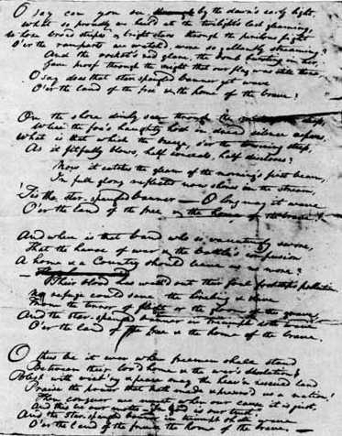
BRITISH INVASIONS
The British were planning two-full-scale invasions of American Territory.
1. In 1814 the British sent a force from Canada across Lake Champlain.
Goal = To cut New England off from the rest of the country.
It failed when the American ships defeated the British at the Battle of Lake Champlain – forcing the British to withdraw to Canada.

Slide 30
BRITISH INVASIONS
2. The next invasion was New Orleans.
By December 1814 dozens of British ships carrying 7,500 troops were approaching Louisiana.
Waiting was Andrew Jackson. Earlier that year he became famous by defeating the Creek Indians, at the Battle of Horseshoe Bend in Alabama.
His army was now made up of frontier militiamen, Native Americans, African-Americans, and pirates.
He planned on defending New Orleans.
-The army built a huge ditch and behind it, an earthen wall.
-On January 8, 1815 the British marched in perfect formation and attacked.
-From behind the wall the Americans mowed down the British: American casualties = 21, British = 2,030.
This victory made Jackson a hero of the west.
The battle was unnecessary.

Slide 31
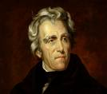
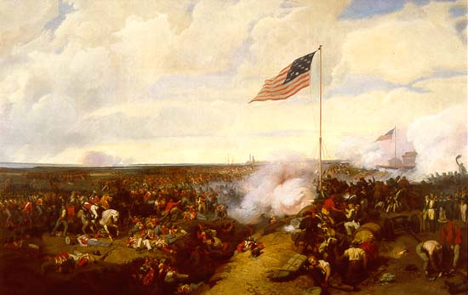
NEW ORLEANS CONTINUED
The war had already ended.
A peace treaty was made two weeks earlier = THE TREATY OF GHENT.
-The treaty showed the lack of a clear winner in the war.
-No territory changed hands.
Border and trade disputes were resolved in later talks.
The War of 1812 was serious:
If the British strategy worked, the U.S. might not have survived.

Slide 32
STATES’ RIGHTS
New England merchants and shippers had bitterly opposed the War of 1812:
1. The Republicans were willing to destroy trade in favor of interests of the south and west.
2. they referred to it as Mr. Madison’s War.
3. Some New England States began to talk of secession.
4. Some were considering a separate peace with Britain.
Massachusetts issued a call to neighboring states to meet at Hartford, Connecticut.
HARTFORD CONVENTION =
Instead of secession, new constitutional amendments were proposed;
-limiting the power of Congress to impose embargoes, restrict trade, make war, or admit new states.
-do away with the Three-fifths Compromise.
-states had the right to repeal acts of Congress.

Slide 33
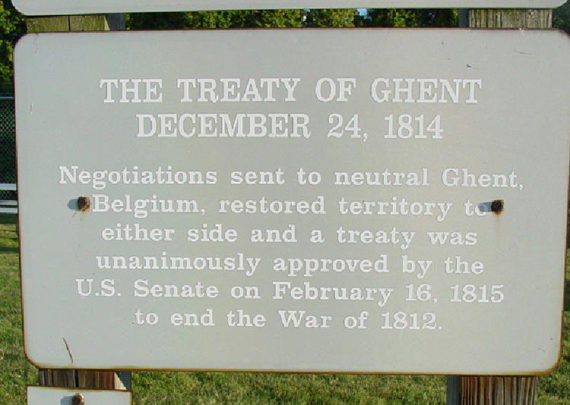
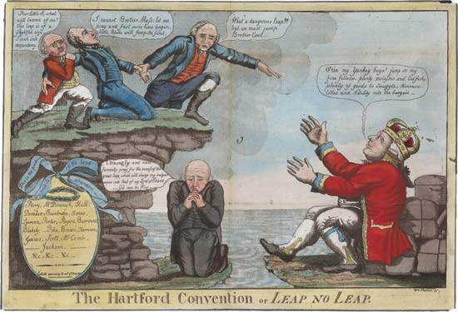
HARTFORD CONVENTION CONTINUED
The convention chose delegates to take the message to President Madison in Washington D.C.
The city has just learned of the victory at New Orleans and the peace treaty, causing celebrations in the capital.
The Federalist felt out of place and would not be heard.
They left town, little more was heard on the subject, and the Federalist party soon was gone.

Slide 34
CHAPTER 14
NATIONALISM
ERA OF GOOD FEELINGS
JOHN MARSHALL AND EARLY SUPREME COUORT DECISIONS (CHART ASSIGNMENT-PRESENTATION)

Slide 35
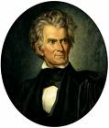
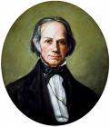
THE AMERICAN SYSTEM
John C. Calhoun of South Carolina and Henry Clay of Kentucky promoted the NATIONALIST point of view.
They both also helped to promote the AMERICAN SYSTEM:
1. The U.S. should be self-sufficient (buy American made goods – high tariffs of imports)
2. A national bank to strengthen the country’s financial system.
3. Improve transportation to help trade within the country.

Slide 36
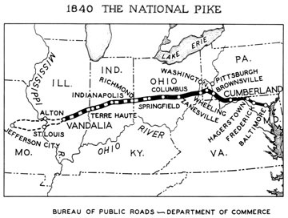
THE NATIONAL ROAD
After the War of 1812 Congress voted in money to finish a NATIONAL ROAD = to connect sections of the U.S.
By 1820 the CUMBERLAND ROAD (National Road) crossed the Appalachians, connecting Cumberland, Maryland with Wheeling (West Virginia) on the Ohio River.
By 1833 it reached Columbus, Ohio.
Other roads would be built by states.
Pikes = early toll gates or polls.

Slide 37
THE ERIE CANAL
The Erie Canal, paid for by the state of New York, made possible an all-water route from New York City to the Great Lakes.
Most believed that it was impossible = 350 miles through wilderness.
New York’s governor DeWitt Clinton made it possible.
Building the “big ditch” had problems:
1. The water level in Lake Erie is 550 feet higher than the Hudson River.
2. Forest to clear, and valleys to cross.
3. 80 locks needed to be installed.
4. Most of the digging was done by men using pickaxes, shovels, and wheelbarrows.
The building of the canal brought thousands of Irish immigrants to the U.S. = 80 cents a day plus room and board (three times the rate in Ireland)
In 1825 after eight years the Erie Canal was finished.

Slide 38
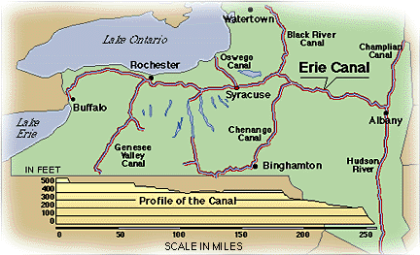
THE ERIE CANAL CONTINUED

Slide 39
EFFECTS OF THE ERIE CANAL
1. Amount for transporting goods form New York City to the Great Lakes declined.
2. the time it took was cut in half.
3. Opened the upper Ohio Valley and the Great Lakes Region to settlement (more immigrants)
4. Farm products from the west went to the east = allowing the eastern cities to grow.
5. The east could focus on trade and manufacturing.
6. The westerners bought the manufactured goods of the east.
7. Trade on the canal helped to make New York City the nation’s largest city.
8. The success of the Erie Canal encouraged canal-building in other sections of the country. (1825 – 1850, Canal Era)
Lake Michigan – Illinois River = Illinois/Michigan Canal.
The Ohio River-Lake Erie = Ohio and Erie Canal.

Slide 40
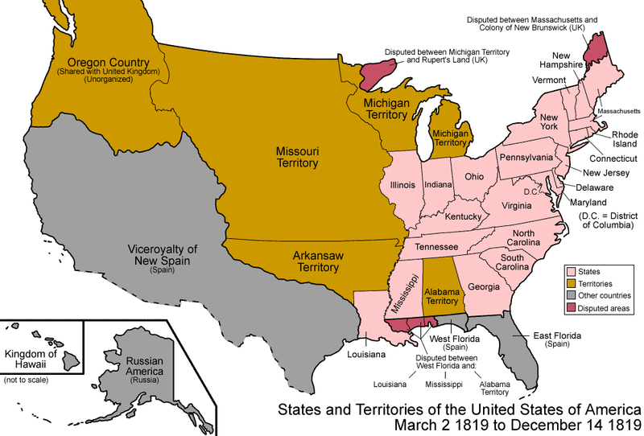
THE U.S. GAINS FLORIDA
In 1810 President Madison declared part of West Florida to belong to the U.S.
During the War of 1812 the U.S. occupied more of West Florida.’
By 1815 the Spanish strength was limited to three forts at St. Marks, Pensacola, and St. Augustine. (Spain was to weak to fight)
The Seminole Indians of Florida tried to prevent white settlers from taking over.
By 1816 a state of War existed between the U.S. and the Seminole.

Slide 41
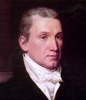
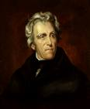
FLORIDA CONTINUED
In 1817 President Monroe sent Andrew Jackson into Georgia and Florida to crush the Seminole.
Jackson went into Spanish Territory and captured St. Marks and St. Augustine and claimed Florida for the U.S.
Congress was angry saying Jackson acted without permission.
European nations were outraged = broke international law.
Spain realized that it was better to sell Florida than to have it seized.
Adams – Onis Treaty 0f 1819 = Spain gave East and West Florida to the U.S.

Slide 42
THE MONROE DOCTRINE
In 1815 an alliance of Britain, Austria, Russia, and Prussia had defeated Napoleon.
The King of Spain had regained his throne and wanted his American Empire back.
The King of Spain looked to other European Monarchs for helped and many agreed.
Britain opposed the plan = Wanted Latin American countries independent so it could trade with them.
The United States wanted to keep rivals out of the Americas.
In 1823 President Monroe delivered the MONROE DOCTRINE = The United States told European countries to stay out of the Americas.
The U.S. needed to be able to enforce it = Britain with its giant Navy, stood behind it.

Slide 43
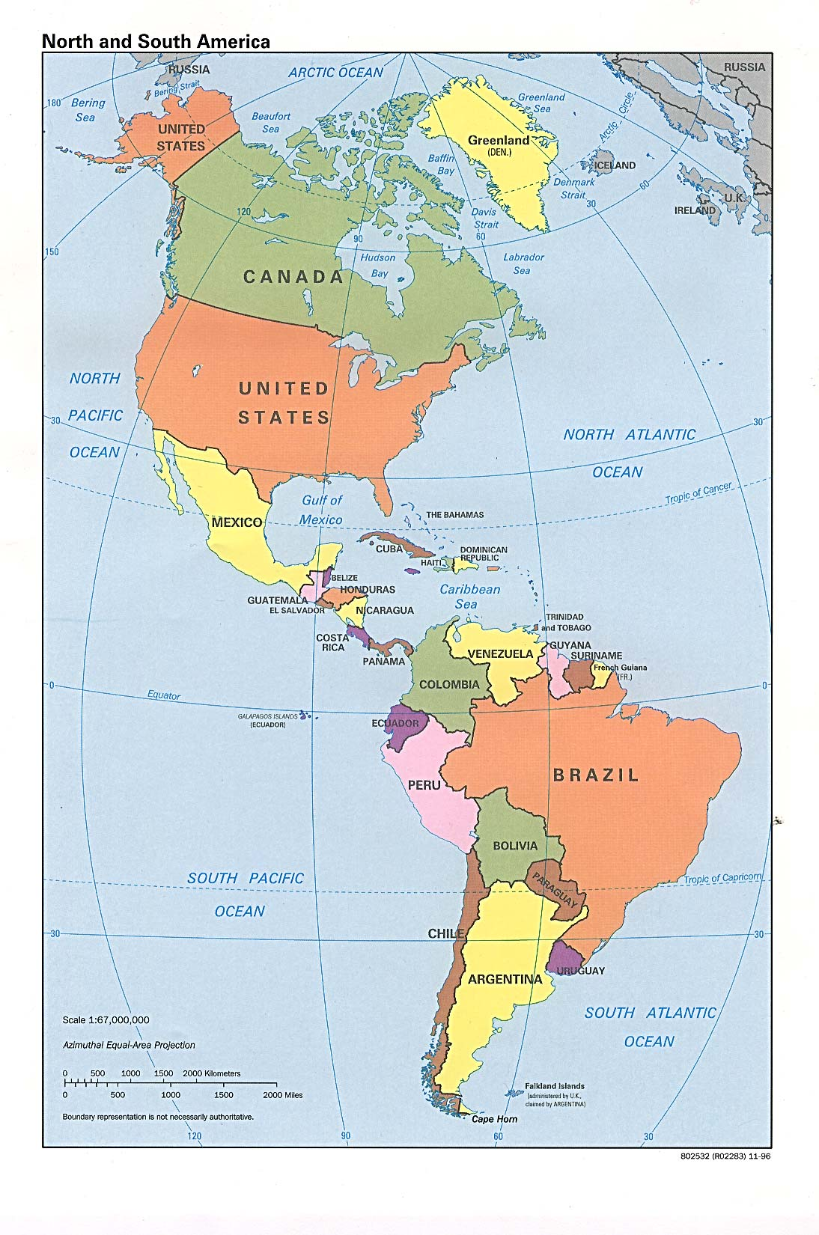
MONROE DOCTRINE

Slide 44
THE MISSOURI COMPROMISE
In 1820 the territory of Missouri applied for statehood.
Many people in Missouri wanted slavery to be allowed.
At the time there were eleven free states and eleven slave states – Missouri would tip the balance.
Missouri would give more power in congress to one section or the other.
SECTIONALISM was beginning in the United States.
The debate over Missouri went on for months in Congress.
At this this time Maine declared itself ready for statehood.
Henry Clay from Kentucky came up with the MISSOURI COMPROMISE = Maine be admitted as a free state and Missouri as a slave state, it was passed by congress in 1820.
Slavery would also be banned from the Louisiana Territory north of the parallel 36 degrees 30 minutes, Missouri’s southern border.

Slide 45
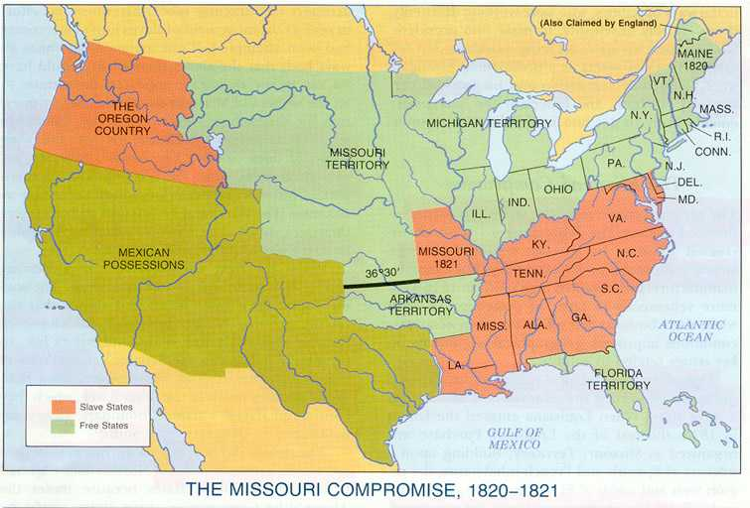
MISSOURI COMPROMISE

Slide 46
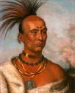
NATIVE AMERICANS
As president, John Quincy Adams refused to remove the Native Americans from the east to the west.
Once Andrew Jackson became president things changed – he proposed to congress the INDIAN REMOVAL ACT = congress passed this in 1830, the act called for the removal of all eastern Indians to territories west of the Mississippi River (Oklahoma)
Not all of the Native Americans went peacefully:
-The Sauk Indians of Wisconsin and Illinois lead by a chief named BLACK HAWK tried to lead his people back in 1832.
The United States Army and the Illinois militia had to be brought in to crush the uprising.
The Black Hawk War was the last Indian war of the Midwest.

Slide 47
THE SEMINOLE
In 1835 the Seminole Indians refused to leave.
A young chief named Osceola became their leader = declared that his people would fight to the end.
In 1837 the Americans raised a flag of truce to discuss peace with Osceola – during the talks Osceola and his men were captured, put in chains, and sent to prison.
Osceola died of disease in prison.
The Seminole fought for seven years, until they were almost wiped out – most that remained moved west.

Slide 48
THE TRAIL OF TEARS
The Cherokee also resisted leaving Georgia, but not by fighting.
The Cherokee appealed to the Supreme Court = they used the treaty made with the federal government, guaranteeing their lands.
They argued the state could not overrule a federal treaty.
In 1832 Chief Justice John Marshall ruled in favor of the Cherokee.
President Jackson should have obeyed the court, instead he ignored it.
Some Cherokee gave up and moved west, most remained in Georgia.
In 1838 Federal troops rounded up the 15,000 remaining Cherokee and began moving them west.
They were forced to march in the cold and rain of winter.
The journey became known as THE TRAIL OF TEARS, with one quarter of the Cherokee dead.

Slide 49
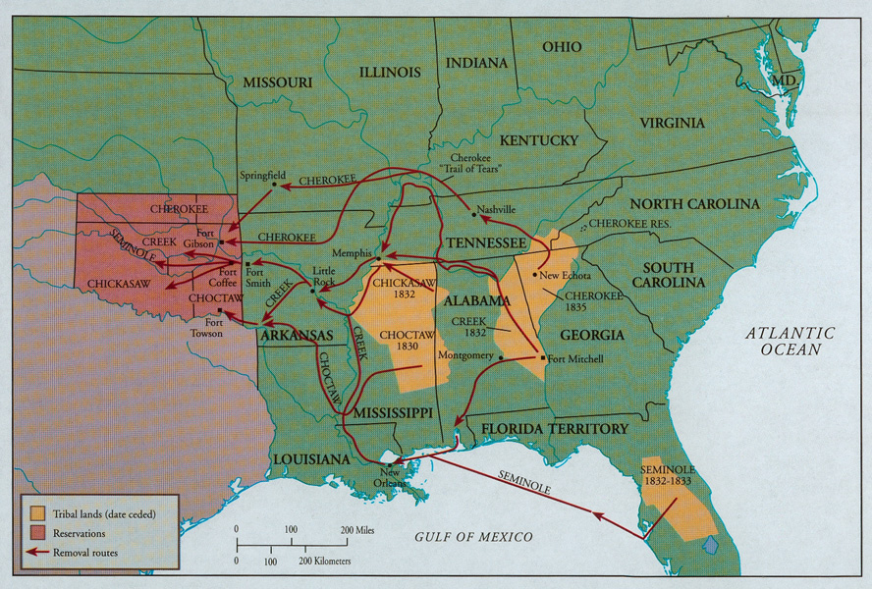
TRAIL OF TEARS

